Slide 1
Optimal control with singular dynamics: Application to controlling chemical bond-breaking
Reuven Eitan and David J. Tannor
Batsheva de Rothschild Seminar, Tsfat, September 2012

Slide 2
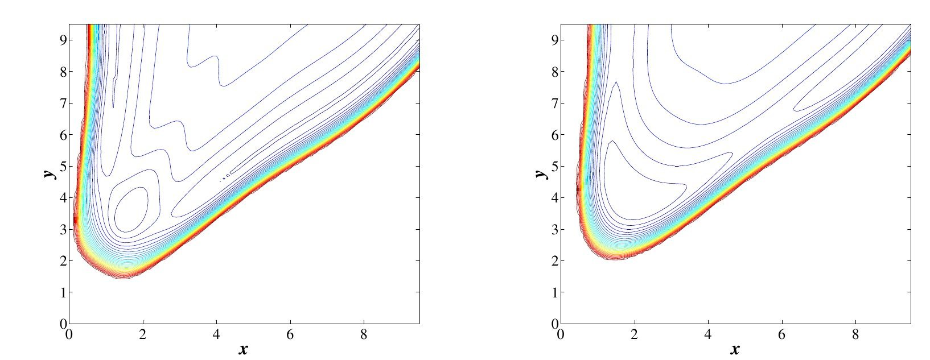
Optimal control with singular dynamics: Application to controlling chemical bond-breaking

Slide 3
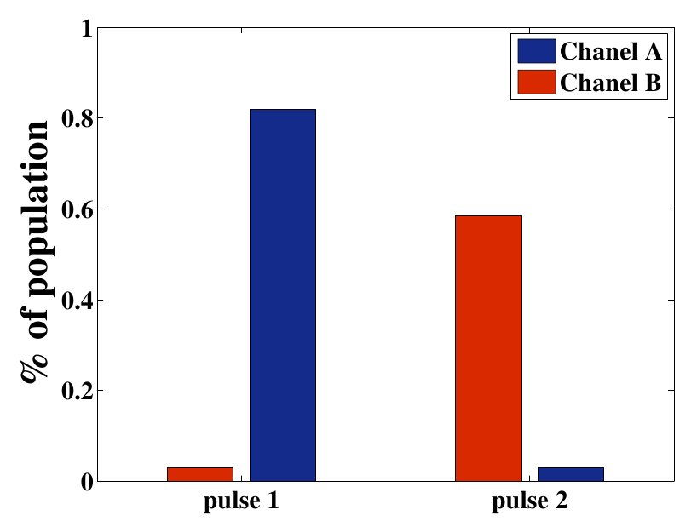
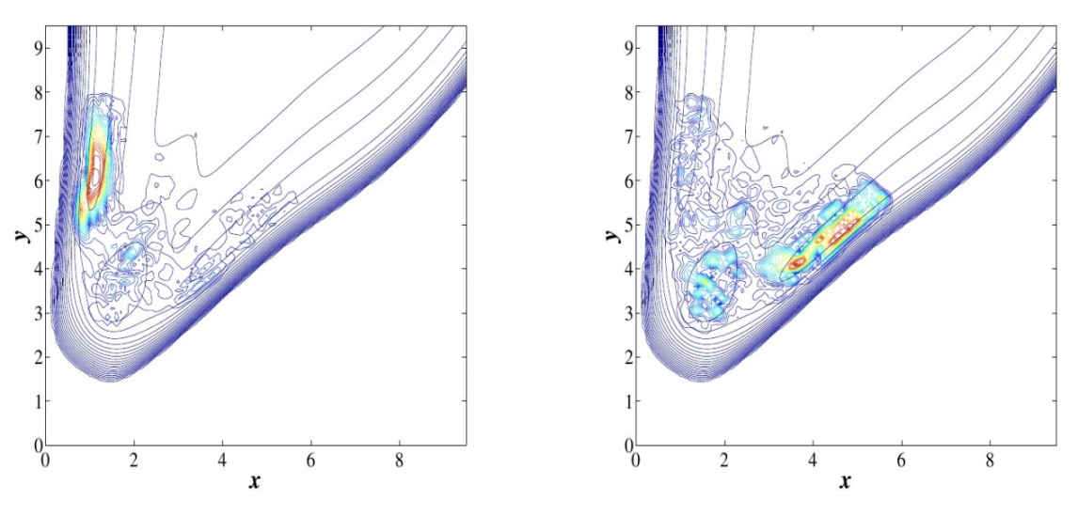
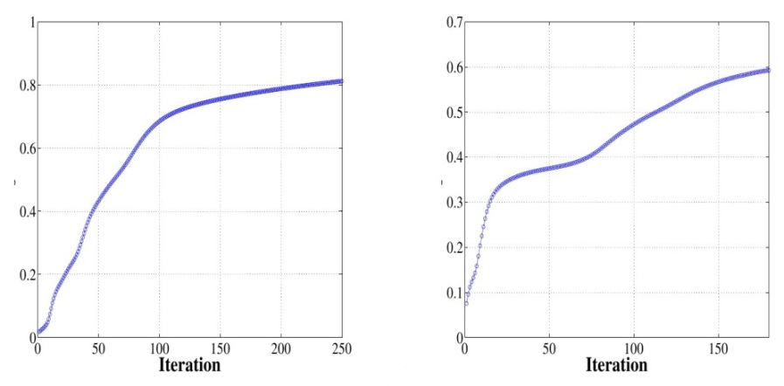
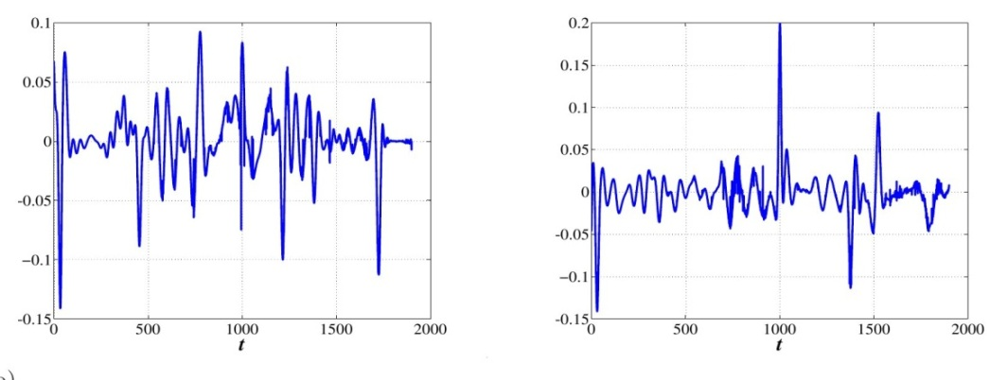
Optimal control with singular dynamics: Application to controlling chemical bond-breaking
Gaussian function

Slide 4
