Slide 1
Succinct Graph Structures
and Their Applications
Spring 2024
Class 7: Reachability Shortcut

Slide 2
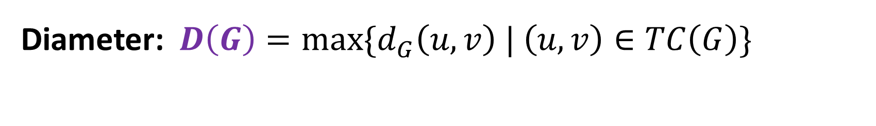



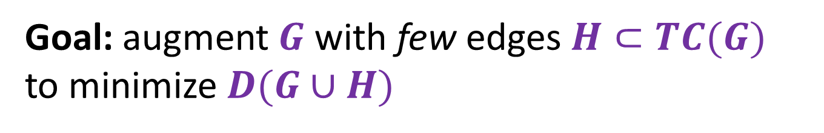
Computation in Directed Graphs
Directed graph $G=\left(V,E\right)$, transitive closure $TC(G)$
$\left(u,v\right)∈TC\left(G\right)$iff $u ↝v$
Diameter: $D\left(G\right)=max\{d_{G}\left(u,v\right) | \left(u,v\right)∈TC\left(G\right)\}$
Complexity grows with graph’s diameter
$$s$$
Goal: augment $G$ with few edges $H⊂TC(G)$
to minimize $D(G∪H)$

Slide 3

Diameter Reducing Shortcuts
[Ullman and Yannakakis ’91, Thorup ’92]
A collection of edges $H⊆TC(G)$ is a $d$-shortcut if $D\left(G∪H\right)≤d$
Linear Shortcuts: $\left|H\right|=O\left(\left|V\right|\right)$
Matching Shortcuts: $\left|H\right|=O\left(\left|E\right|\right)$
Objective: optimize tradeoff between size $|H|$ and diameter $d$

Slide 4
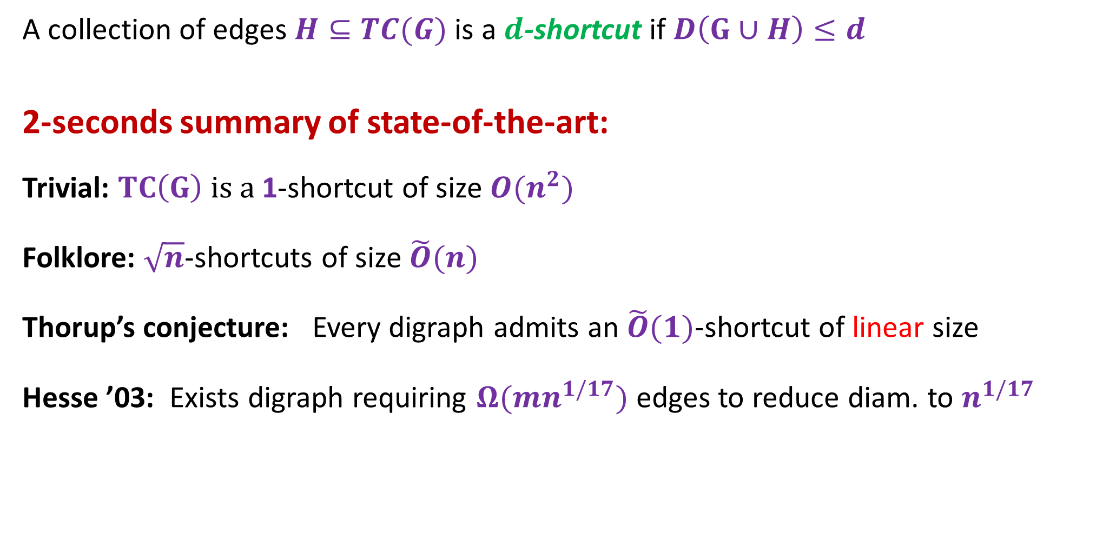
Diameter Reducing Shortcuts
[Ullman and Yannakakis ’91, Thorup ’92]
A collection of edges $H⊆TC(G)$ is a $d$-shortcut if $D\left(G∪H\right)≤d$
2-seconds summary of state-of-the-art:
Trivial: $TC\left(G\right) is a$1-shortcut of size $O(n^{2})$
Folklore: $\sqrt{n}$-shortcuts of size $\tilde{O}(n)$
Thorup’s conjecture: Every digraph admits an $\tilde{O}(1)$-shortcut of linear size
Hesse ’03: Exists digraph requiring $Ω(mn^{1/17})$ edges to reduce diam. to $n^{1/17}$

Slide 5
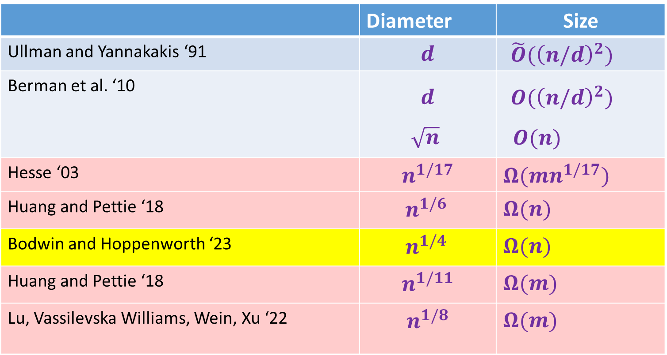
Sparsity vs. Diameter Tradeoffs of Shortcuts
A collection of edges $H⊆TC(G)$ is a $d$-shortcut if $D\left(G∪H\right)≤d$
 | Diameter | Size
Ullman and Yannakakis ‘91 | $$d$$ | $\tilde{O}({\left(n/d\right)}^{2})$
Berman et al. ‘10 | $$d$$ $\sqrt{n}$ | $O({\left(n/d\right)}^{2})$ $O(n)$
Hesse ‘03 | $$n^{1/17}$$ | $Ω(mn^{1/17})$
Huang and Pettie ‘18 | ${ n}^{1/6}$ | $Ω(n)$
Bodwin and Hoppenworth ‘23 | ${ n}^{1/4}$ | $Ω(n)$
Huang and Pettie ‘18 | $$n^{1/11}$$ | $Ω(m)$
Lu, Vassilevska Williams, Wein, Xu ‘22 | $$n^{1/8}$$ | $Ω(m)$
Linear shortcut
Matching
shortcut

Slide 6




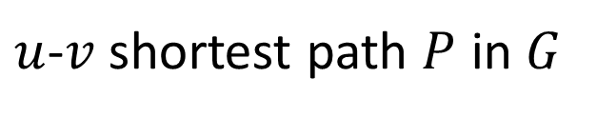
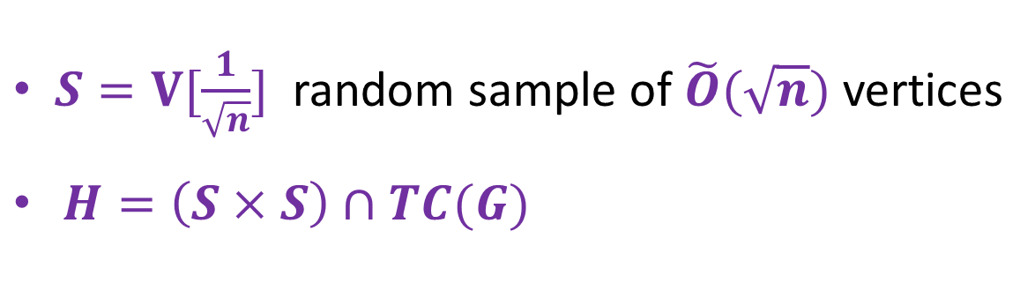
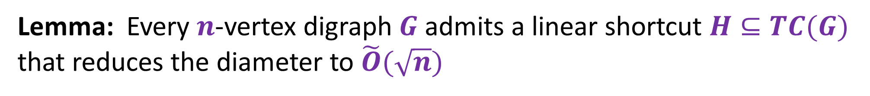
Linear Shortcuts for General Digraphs
Lemma: Every $n$-vertex digraph $G$ admits a linear shortcut $H⊆TC(G)$
that reduces the diameter to $\tilde{O}(\sqrt{n})$
$S=V[\frac{1}{\sqrt{n}}]$ random sample of$\tilde{O}(\sqrt{n})$ vertices
$H=\left(S×S\right)∩TC(G)$
$$u$$
$$v$$
$$\sqrt{n}$$
$u$-$v$ shortest path $P$ in $G$
$$\sqrt{n}$$

Slide 7
Linear Shortcuts are Useful
Parallel
Distributed
Dynamic
Reachability
[Fineman ’20, LJS ’19]
Reachability
[LJS ’19]
Reachability
[HKN ‘14]
SSSP
[BPGWN ’20],[PGWN ‘20]
Approx. Shortest Paths
[CFR ’21] [KS ‘21]
SSSP
[BPGWN ’20]
Is it possible to break the $\sqrt{n}$ diameter barrier using $\tilde{O}(n)$ shortcut edges?

Slide 8
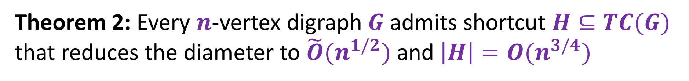

New Tradeoffs for Shortcuts
[KP SODA’22]
Linear Shortcuts
Theorem 1: Every $n$-vertex digraph $G$ admits a linear shortcut
$H⊆TC(G)$ that reduces the diameter to $\tilde{O}(n^{1/3})$
Sublinear Shortcuts
Theorem 2: Every $n$-vertex digraph $G$ admits shortcut $H⊆TC(G)$ that reduces the diameter to $\tilde{O}(n^{1/2})$ and $\left|H\right|=O(n^{3/4})$

Slide 9
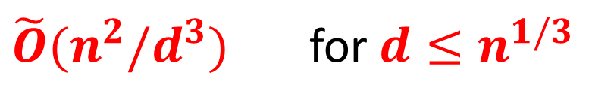
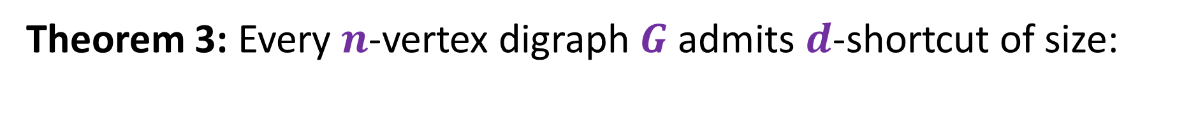
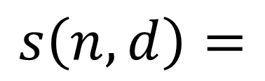
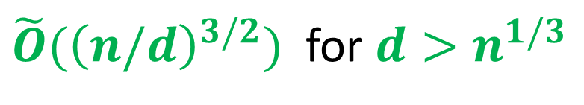
New Tradeoffs for Shortcuts
[KP SODA’22]
Theorem 3: Every $n$-vertex digraph $G$ admits $d$-shortcut of size:
$\tilde{O}(n^{2}/d^{3})$ for $d≤n^{1/3}$
$$s\left(n,d\right)=$$
$\tilde{O}({\left(n/d\right)}^{3/2})$ for $d>n^{1/3}$

Slide 10
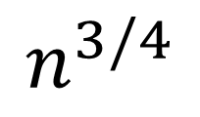
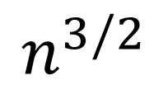
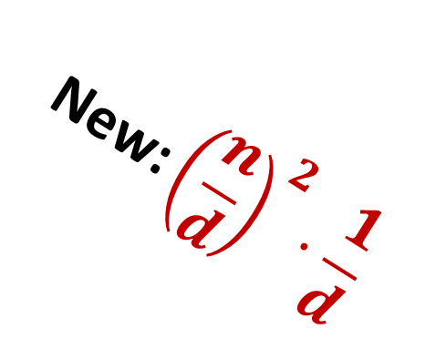
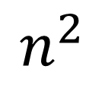

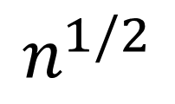
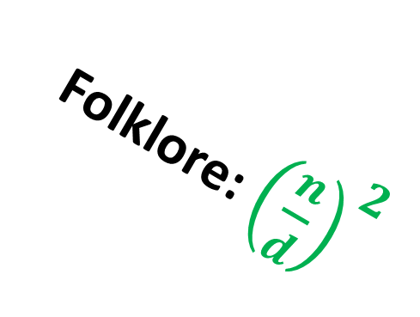
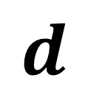
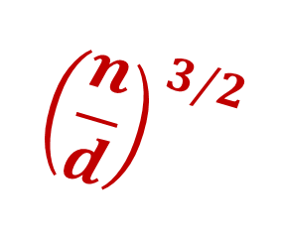

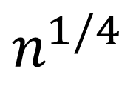
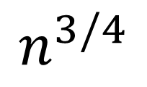
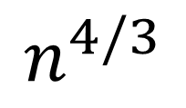
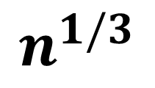

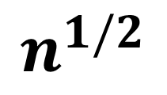
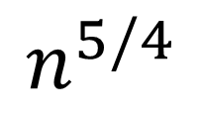
New Diameter-Size Tradeoffs
Size
$$n^{2}$$
$$n^{3/2}$$
$$n^{4/3}$$
Folklore: ${\left(\frac{n}{d}\right)}^{2}$
$$n^{5/4}$$
$${\text{New}\text{:}\left(\frac{n}{d}\right)}^{2}⋅\frac{1}{d}$$
$$n$$
$$n^{3/4}$$
$${\left(\frac{n}{d}\right)}^{3/2}$$
$$n^{1/2}$$
$$d$$
$$1$$
$$n^{1/4}$$
$$n^{1/3}$$
$$n^{1/2}$$
$$n^{3/4}$$
$$n$$

Slide 11
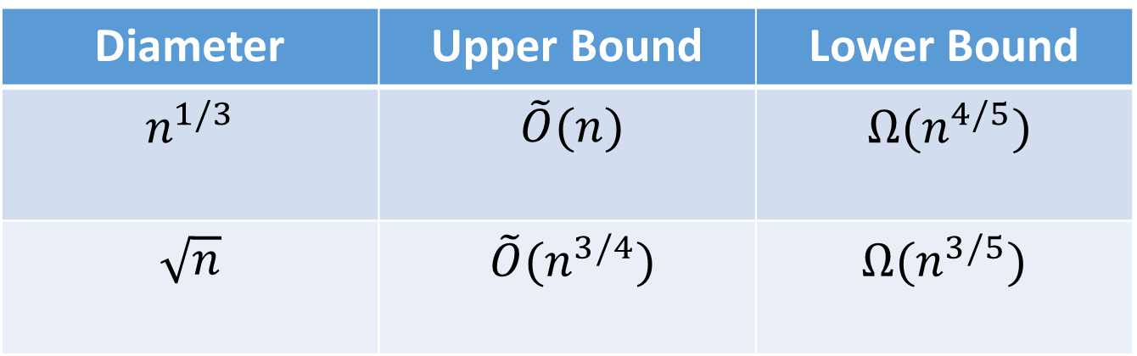
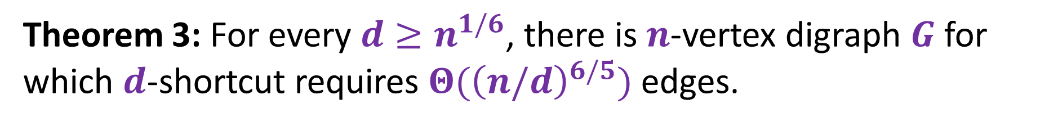
New Lower Bounds for Sublinear Shortcuts
Theorem 3: For every $d≥n^{1/6}$, there is $n$-vertex digraph $G$ for which $d$-shortcut requires $Θ({\left(n/d\right)}^{6/5})$ edges.
Extension of [Huang and Pettie ‘19] to the sublinear regime
Diameter | Upper Bound | Lower Bound
$$n^{1/3}$$ | $\tilde{O}(n)$ | $Ω(n^{4/5})$
$$\sqrt{n}$$ | $\tilde{O}(n^{3/4})$ | $$Ω(n^{3/5})$$

Slide 12

Breaking the $\sqrt{n}$ Barrier
Breaking the $\sqrt{n}$ Barrier Efficiently

Slide 13
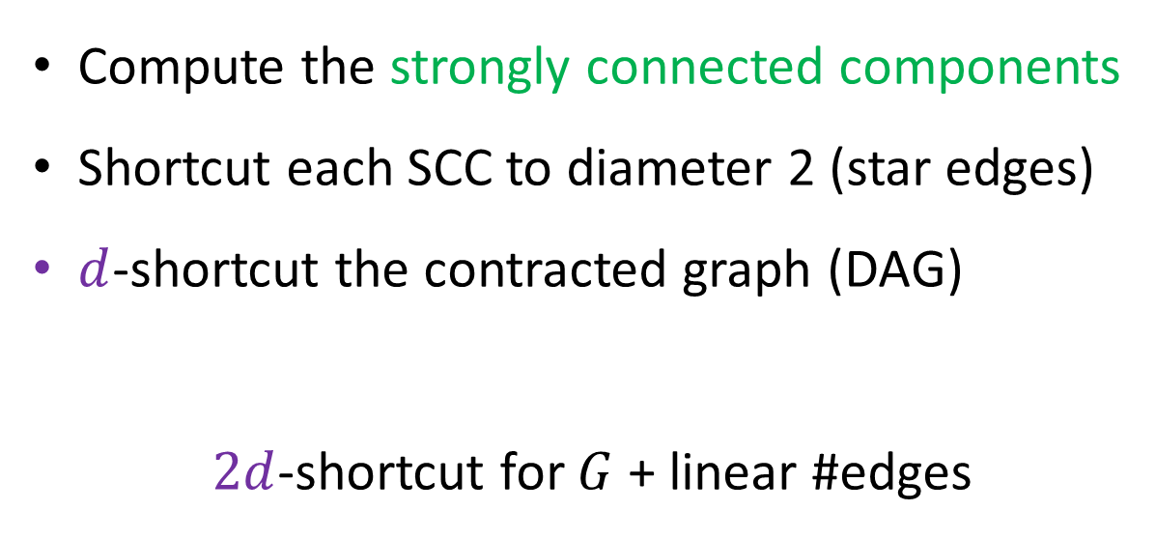
Assume G is a DAG
Compute the strongly connected components
Shortcut each SCC to diameter 2 (star edges)
$d$-shortcut the contracted graph (DAG)
$2d$-shortcut for $G$ + linear #edges

Slide 14
Basic Tool: Shortcutting a Dipath
Lemma: A dipath $P$ admits a 2-shortcut $H(P)$ with $O(\left|P\right|log\left|P\right|)$ edges

Slide 15
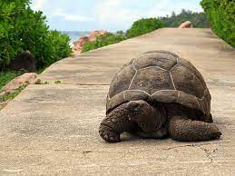
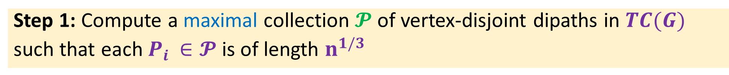
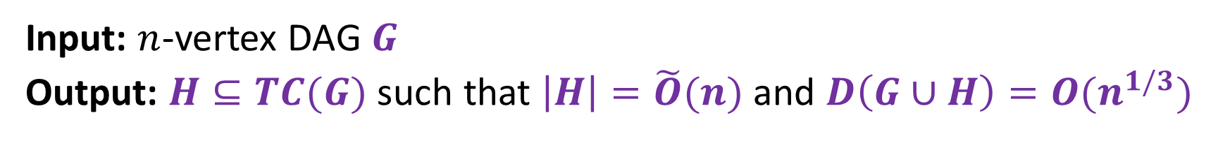
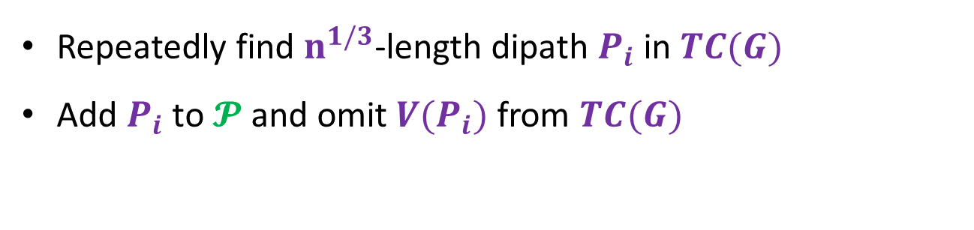
The Shortcut Algorithm
Input: $n$-vertex DAG $G$
Output: $H⊆TC(G)$ such that $\left|H\right|=\tilde{O}(n)$ and $D\left(G∪H\right)=O(n^{1/3})$
Step 1: Compute a maximal collection $𝓟$ of vertex-disjoint dipaths in $TC(G)$
such that each $P_{i }∈𝓟$ is of length $n^{1/3}$
Repeatedly find $n^{1/3}$-length dipath $P_{i}$ in $TC(G)$
Add $P_{i}$ to $𝓟$ and omit $V(P_{i})$ from $TC(G)$
Step 2: $H_{1}=\bigcup_{P_{i}∈𝓟}{H(P_{i})}$ where $H(P_{i})$ is a 2-shortcut for $P_{i}$

Slide 16



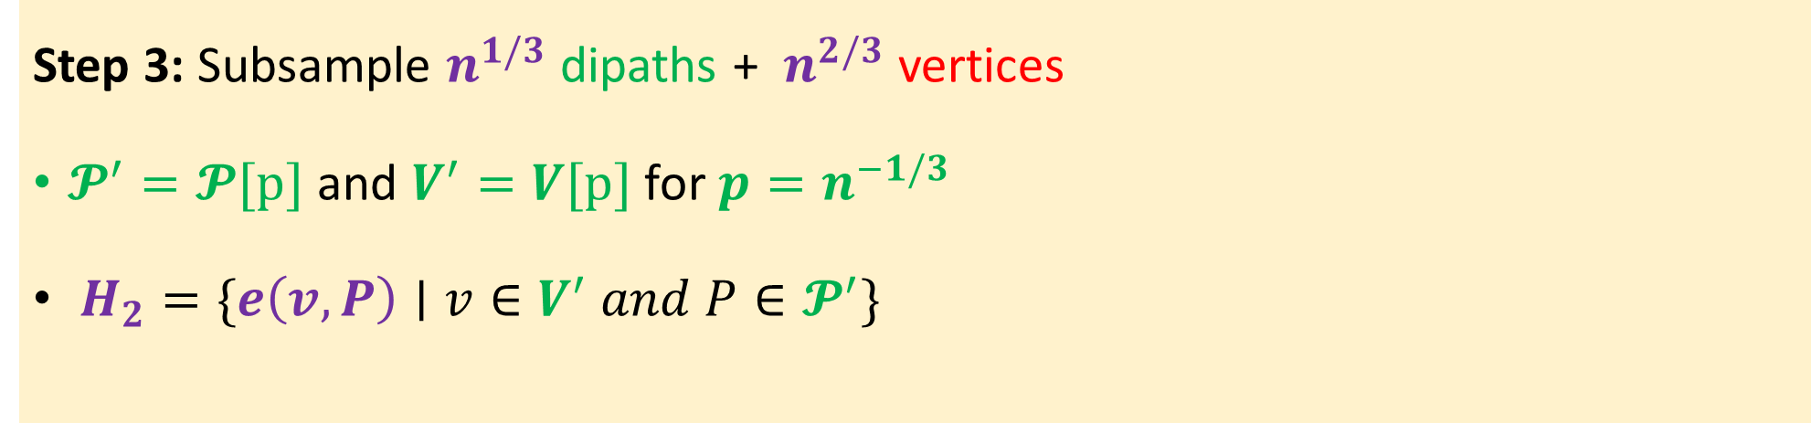
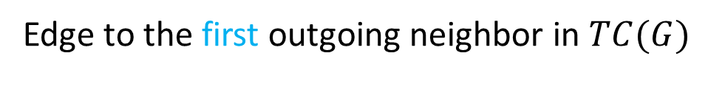




The Shortcut Algorithm
Step 3: Subsample $n^{1/3}$ dipaths + $n^{2/3}$ vertices
$𝓟^{′}=𝓟[p]$ and $V^{′}=V[p]$ for $p=n^{−1/3}$
$H_{2}=\{e\left(v,P\right)∣v∈V^{′} and P∈𝓟^{′}\}$
$e(v,P)$
$$v$$
$$P$$
Edge to the first outgoing neighbor in $TC(G)$
$$V$$
$$𝓟$$
$$…$$
$$…$$

Slide 17

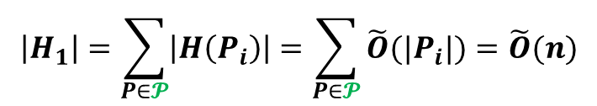


The Shortcut Algorithm: Size Analysis
Step 1: Compute a collection $𝓟$ of $n^{2/3}$ vertex-disjoint dipaths in $TC(G)$
Step 2: $H_{1}=\bigcup_{P_{i}∈𝓟}{H\left(P_{i}\right)∪P_{i}}$ where $H(P_{i})$ is a 2-shortcut for $P_{i}$
$$\left|H_{1}\right|=\sum_{P∈𝓟}{\left|H\left(P_{i}\right)\right|=\sum_{P∈𝓟}{\tilde{O}(|P_{i}|)=\tilde{O}(n)}}$$
Step 3: Subsample $n^{1/3}$ dipaths $𝓟^{′}⊆𝓟$ + $n^{2/3}$ vertices in $V^{′}⊆V$
$$H_{2}=\{e\left(v,P\right)∣v∈V^{′} and P∈𝓟^{′}\}$$
$$\left|H_{2}\right|=\left|𝓟^{′}\right|⋅\left|V^{′}\right|=\tilde{O}(n)$$
Output $H=H_{1}∪H_{2}$

Slide 18
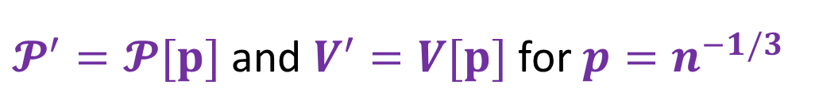









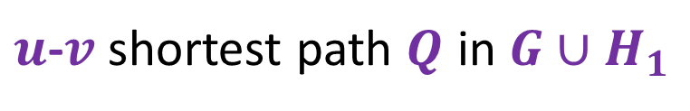


The Diameter Argument
$𝓟^{′}=𝓟[p]$ and $V^{′}=V[p]$ for $p=n^{−1/3}$
$H_{1}=\bigcup_{P_{i}∈𝓟}{H(P_{i})}$ ,
$u$-$v$ shortest path $Q$ in $G∪H_{1}$
?
$$e\left(z,P_{i}\right)∈H$$
$$x$$
$$Q_{1}$$
$$Q_{2}$$
$$P_{i}∈𝓟^{′}$$
$$u$$
$$v$$
$$z$$
$$w$$
$${16n}^{1/3}$$
$${16n}^{1/3}$$

Slide 19


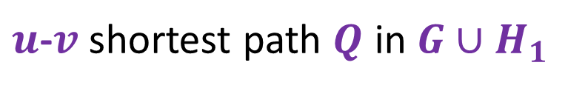



The Diameter Argument
$H_{1}=\bigcup_{P_{i}∈𝓟}{H\left(P_{i}\right)∪P_{i}}$, $𝓟^{′}=𝓟[p]$ and $V^{′}=V[p]$ for $p=n^{−1/3}$
Claim 1: $Q$ contains $<n^{1/3}$ vertices from $V∖\bigcup_{P∈𝓟}{V(P)}$
$$u$$
$$v$$
$$Q$$
$u$-$v$ shortest path $Q$ in $G∪H_{1}$
$$V∖\bigcup_{P∈𝓟}{V(P)}$$
Proof: Immediate by the maximality property of $𝓟^{}$
$$\bigcup_{P∈𝓟}{V(P)}$$

Slide 20


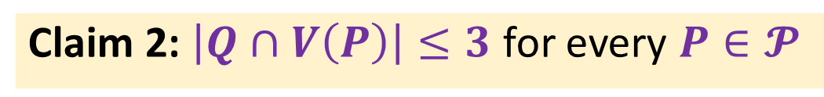

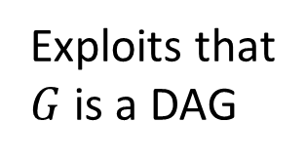

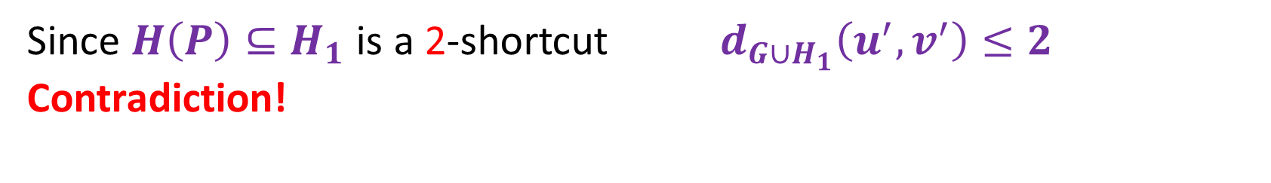




The Diameter Argument
$H_{1}=\bigcup_{P_{i}∈𝓟}{H(P_{i})}$, $𝓟^{′}=𝓟[p]$ and $V^{′}=V[p]$ for $p=n^{−1/3}$
Claim 2: $\left|Q∩V\left(P\right)\right|≤3$ for every $P∈𝓟$
Exploits that
$G$ is a DAG
$$Q$$
$$u^{′}$$
$$v^{′}$$
$$u$$
$$v$$
$u$-$v$ shortest path $Q$ in $G∪H_{1}$
Since $H\left(P\right)⊆H_{1}$ is a 2-shortcut ${ d}_{G∪H_{1}}\left(u^{′},v^{′}\right)≤2$
Contradiction!
$$V(P)$$
$$V∖V(P)$$

Slide 21

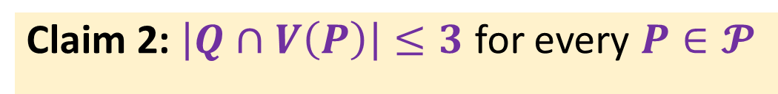

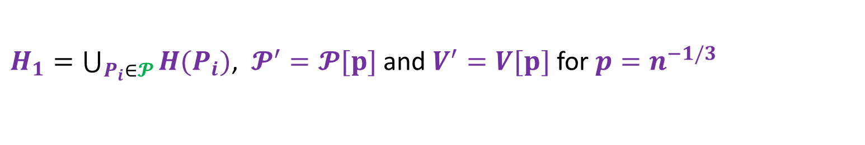

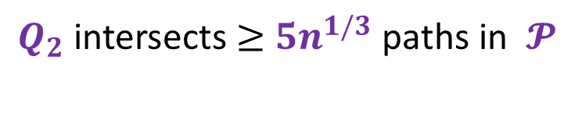
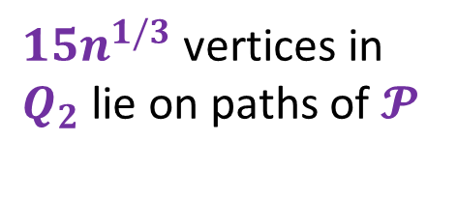

The Diameter Argument
$H_{1}=\bigcup_{P_{i}∈𝓟}{H(P_{i})}$, $𝓟^{′}=𝓟[p]$ and $V^{′}=V[p]$ for $p=n^{−1/3}$
Claim 1: $Q$ contains $<n^{1/3}$ vertices from $V∖\bigcup_{P∈𝓟}{V(P)}$
$15n^{1/3}$vertices in $Q_{2}$lie on paths of $𝓟$
Claim 2: $\left|Q∩V\left(P\right)\right|≤3$ for every $P∈𝓟$
$Q_{2}$intersects $≥$ $5n^{1/3}$ paths in $𝓟$
By Chernoff
Claim 3: W.h.p., the suffix $Q_{2}$ intersects some sampled path in $𝓟^{′}$
$${16n}^{1/3}$$
$$u$$
$$Q_{2}$$
$$v$$

Slide 22












The Diameter Argument
By Claim 3:
$$e\left(z,P_{i}\right)∈H$$
$$x$$
$$Q_{2}$$
$$P_{i}∈𝓟^{′}$$
$$Q_{1}$$
$$v$$
$$u$$
$$z$$
$$w$$
$${16n}^{1/3}$$
$${16n}^{1/3}$$
$$d_{G∪H}\left(u,v\right)=O(n^{1/3})$$

Slide 23










Lets do some math:
Desired diam $d$
$n/d$ dipaths in transitive closure
$n/d^{2}$ sampled paths $×$ $n/d$ sampled nodes
Shortcut size: $\frac{n^{2}}{d^{3}}+n$
$$e\left(z,P_{i}\right)∈H$$
$$x$$
$$P_{i}∈𝓟^{′}$$
$$u$$
$$v$$
$$z$$
$$w$$
$$d/10$$
$$d/10$$

Slide 24











$$x$$
$$P_{j}∈𝓟^{′}$$
$$P_{i}∈𝓟^{′}$$
$$v$$
$$u$$
$$w$$
$$d/10$$
$$z$$
$$d/10$$
$$y$$
$$e\left(P_{j},P_{i}\right)∈H$$

Slide 25













Can we do better: Paths $×$ Paths Construction
Desired diam $d$
$n/d$ dipaths in transitive closure
$n/d^{2}$ sampled paths $×$ $n/d^{2}$ sampled paths
Shortcut size: $\frac{n}{d^{4}}+n$
$$x$$
$$P_{j}∈𝓟^{′}$$
$$P_{i}∈𝓟^{′}$$
$$v$$
$$u$$
$$w$$
$$d/10$$
$$z$$
$$d/10$$
$$y$$
$$e\left(P_{j},P_{i}\right)∈H$$

Slide 26











Can we do better: Paths $×$ Paths Construction
$n/d^{2}$ sampled paths $×$ $n/d^{2}$ sampled nodes = $n/d^{4}$
Fails: Sublinear #edges cannot capture reachability between pair of dipaths!
$$u_{1}$$
$$u_{2}$$
$$u_{3}$$
$$u_{4}$$
$$u_{5}$$
$$v_{1}$$
$$v_{2}$$
$$v_{3}$$
$$v_{4}$$
$$v_{5}$$

Slide 27


Open Ends
Directed Shortcuts
Current gap for linear shortcuts: $O(n^{1/3})$ vs. $Ω(n^{1/4})$
Improved computation: sequential, distributed and parallel
Applications: reachability in near-linear time and $o(\sqrt{n})$ depth
Thank you!
Exact Directed Hopsets
Breaking $\sqrt{n}$barrier for directed exact hopsets (if possible)
Exciting update: $\sqrt{n}$ is tight! [Bodwin and Hoppenworth ‘23]

