Slide 1
Succinct Graph Structures and Their Applications
Spring 2020
Class 4: Routing Schemes

Slide 2





Compact Routing Schemes
A distributed protocol to deliver packets from any node of a network to any other node.
Forward a message from source to destination
through a chain of intermediate nodes
Each node makes a decision on the next hop
based on the header of the msg and
its routing-table
$$R(u)$$
$$u$$
$$d$$
$$s$$

Slide 3







Routing Schemes
Preprocessing phase: computes for each vertex $v$
  Label $L(v)$ (address of $v)$
  Routing table $R(v)$
Routing phase, for every vertex $u$:
Input: H$eader (L\left(v\right))$, routing table $R(u)$
Output: Next-hop (port number of $u)$
Objective: small-space labels and routing tables
small-stretch paths
$$R(u)$$
$$u$$
Header: $L(v)$
$$v$$
$$s$$

Slide 4









Routing Schemes: Two Extreme Solutions
Label $L(u)=ID(u)$
Routing table $R(u)$
Header: $L(v)$
Destination | Next-Hop
$$v_{1}$$ | $w_{1}$
$$v_{2}$$ | $$w_{2}$$
$$v_{n}$$ | $$w_{3}$$
$$u$$
$$…$$
$$w_{1}$$
$$w_{2}$$
$$w_{3}$$
$$w_{4}$$
Tables of linear size

Slide 5
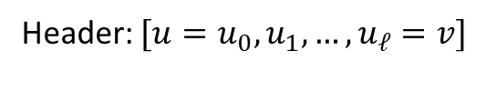




Routing Schemes: Two Extreme Solutions
Header (u → v): $[u=u_{0}, u_{1}, …, u_{ℓ}=v]$
$$u$$
Headers of linear size
Header: $[u=u_{0}, u_{1}, …, u_{ℓ}=v]$
Goal:
Poly-log header size
Sublinear routing tables
$$…$$
Must resort to approx. distances
$$v$$

Slide 6


The Best One Can Hope For*
*Under Girth Conjecture
Routing Schemes define paths and distances between all pairs
Last Class: Erdos girth conjecture implies $Ω(n^{1+\frac{1}{k}})$ space for $(2k−1)$ stretch
For stretch $2k−1,$ there must be a
vertex $u$with $\left|R\left(u\right)\right|=Ω(n^{1/k})$

Slide 7

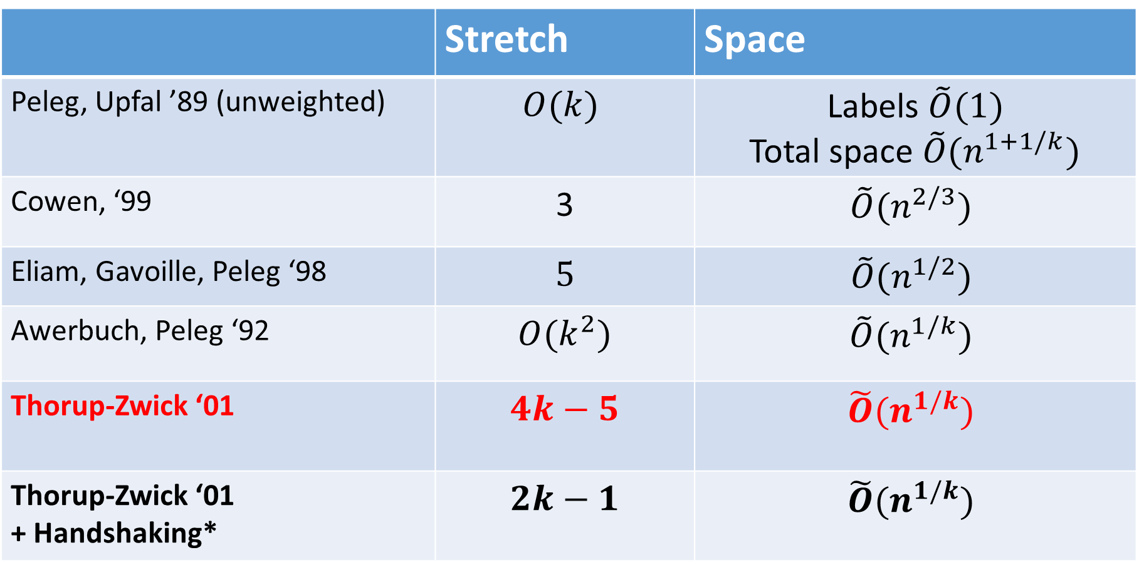
History of Routing Schemes
 | Stretch | Space
Peleg, Upfal ’89 (unweighted) | $$O(k)$$ | Labels $\tilde{O}(1)$ Total space $\tilde{O}(n^{1+1/k})$
Cowen, ‘99 | 3 | $$\tilde{O}(n^{2/3})$$
Eliam, Gavoille, Peleg ‘98 | $$5$$ | $$\tilde{O}(n^{1/2})$$
Awerbuch, Peleg ‘92 | $$O(k^{2})$$ | $$\tilde{O}(n^{1/k})$$
Thorup-Zwick ‘01 | $$4k−5$$ | $$\tilde{O}(n^{1/k})$$
Thorup-Zwick ‘01 + Handshaking* | $$2k−1$$ | $$\tilde{O}(n^{1/k})$$
*source and destination agree on $\tilde{O}(1)$ bits

Slide 8
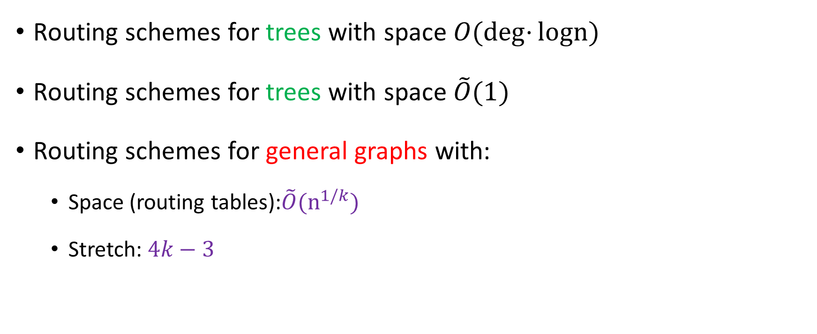
Outline
Routing schemes for trees with space $O(\deg{⋅}logn)$
Routing schemes for trees with space $\tilde{O}(1)$
Routing schemes for general graphs with:
  Space (routing tables):$\tilde{O}(n^{1/k})$
  Stretch: $4k−3$

Slide 9





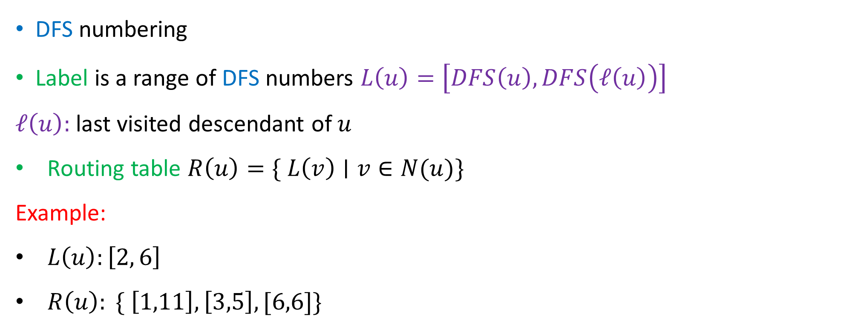







Interval Routing [Santoro, Khatib ‘85]
DFS numbering
Label is a range of DFS numbers $L\left(u\right)=\left[DFS\left(u\right), DFS\left(ℓ\left(u\right)\right)\right]$
$ℓ\left(u\right):$ last visited descendant of $u$
Routing table $R\left(u\right)=\{ L\left(v\right)∣v∈N(u)\}$
Example:
$L\left(u\right):\left[2, 6\right]$
$R\left(u\right): \{ \left[1,11\right], \left[3,5\right],[6,6]\}$
$$1$$
$$u$$
$$2$$
$$7$$
$$8$$
$$3$$
$$6$$
$$9$$
$$10$$
$$11$$
$$4$$
$$5$$

Slide 10


















Interval Routing
$$1$$
$$L\left(v\right)=[3,5]$$
$$R\left(s\right)=\{ \left[1,11\right], \left[9,9\right],\left[10,10\right],[11,11]\}$$
$$R\left(1\right)=\{ \left[2,5\right], \left[7,7\right],\left[8,11\right]\}$$
$$2$$
$$8$$
$$7$$
$$s$$
$$R\left(2\right)=\{ \left[3,5\right], [6,6]\}$$
$$3$$
$$6$$
$$v$$
Each $R\left(u\right)$ requires $O(\deg\left(u\right)log n)$ bits
$$4$$
$$5$$
$$9$$
$$10$$
$$11$$

Slide 11
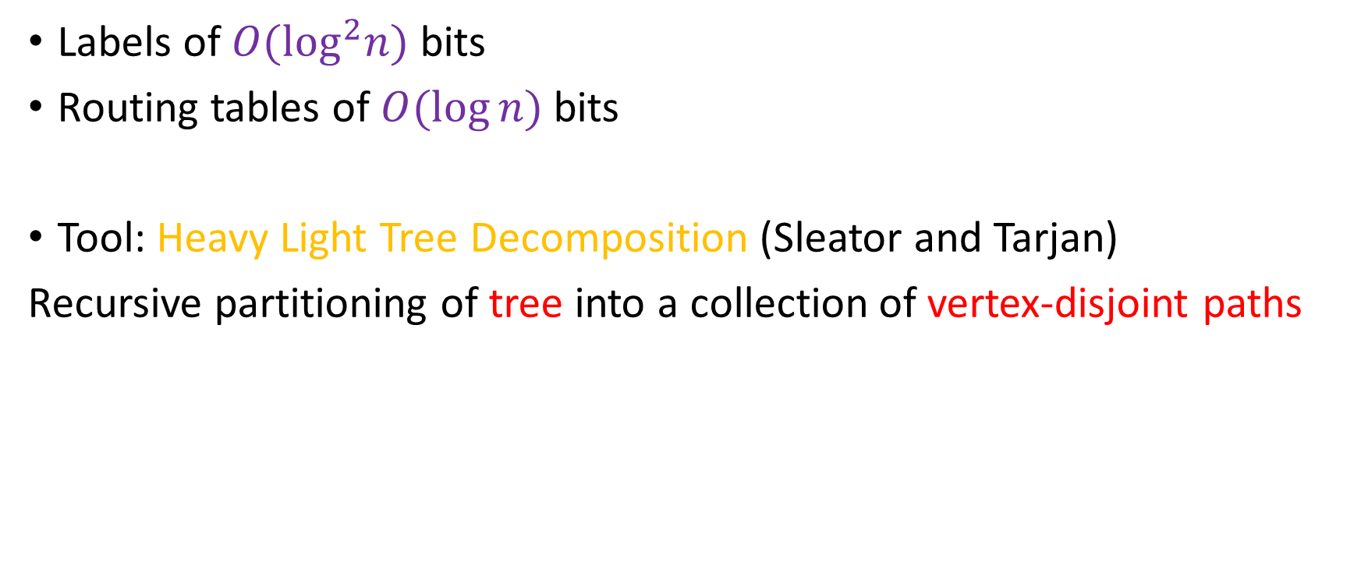
Improved Routing Schemes for Trees [TZ’01]
Labels of $O(\log^{2}n)$ bits
Routing tables of $O(\log{n)}$bits
Tool: Heavy Light Tree Decomposition (Sleator and Tarjan)
Recursive partitioning of tree into a collection of vertex-disjoint paths

Slide 12

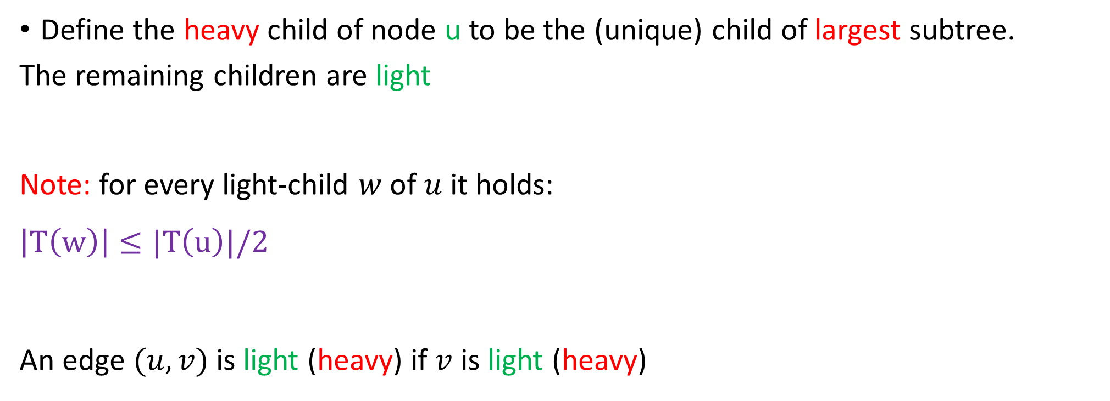


Heavy-Light Tree Decomposition
Define the heavy child of node u to be the (unique) child of largest subtree.
The remaining children are light
Note: for every light-child $w$of $u$ it holds:
$$\left|T\left(w\right)\right|≤|T\left(u\right)|/2$$
An edge $(u,v)$is light (heavy) if $v$ is light (heavy)
$$s$$
$$u$$
$$v$$

Slide 13
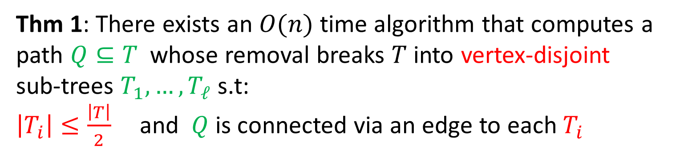


Heavy-Light Tree Decomposition
Thm 1: There exists an $O(n)$ time algorithm that computes a path $Q⊆T$ whose removal breaks $T$ into vertex-disjoint
sub-trees $T_{1},…,T_{ℓ}$ s.t:
$\left|T_{i}\right|≤\frac{\left|T\right|}{2}$and $Q$ is connected via an edge to each $T_{i}$
$$s$$
$$u$$
Proof: simply go to heavy-child on each step
$$v$$
The HL decomposition is given by applying
recursively Thm .1

Slide 14
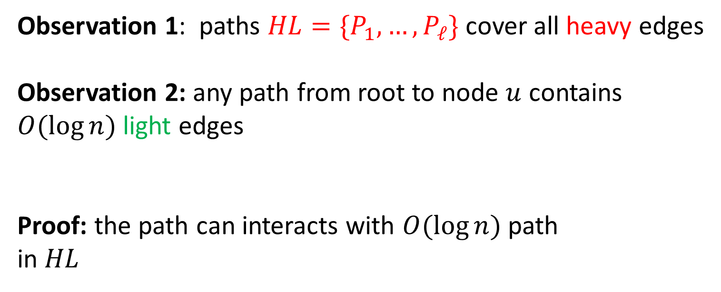
Heavy-Light Tree Decomposition
Observation 1: paths ${HL=\{P}_{1},…, P_{ℓ}\}$ cover all heavy edges
Observation 2: any path from root to node $u$ contains
$O(\log{n)}$light edges
Proof: the path can interacts with $O(\log{n)}$ path
in $HL$

Slide 15

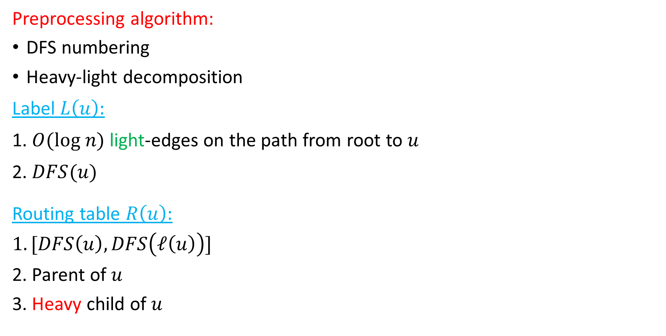
Improved Routing Scheme for Trees
Preprocessing algorithm:
DFS numbering
Heavy-light decomposition
Label $L\left(u\right):$
1. $O(log n)$ light-edges on the path from root to $u$
2. $DFS(u)$
Routing table $R\left(u\right):$
$$1. [DFS\left(u\right), DFS\left(ℓ\left(u\right)\right)]$$
2. Parent of $u$
3. Heavy child of $u$
$$u$$

Slide 16

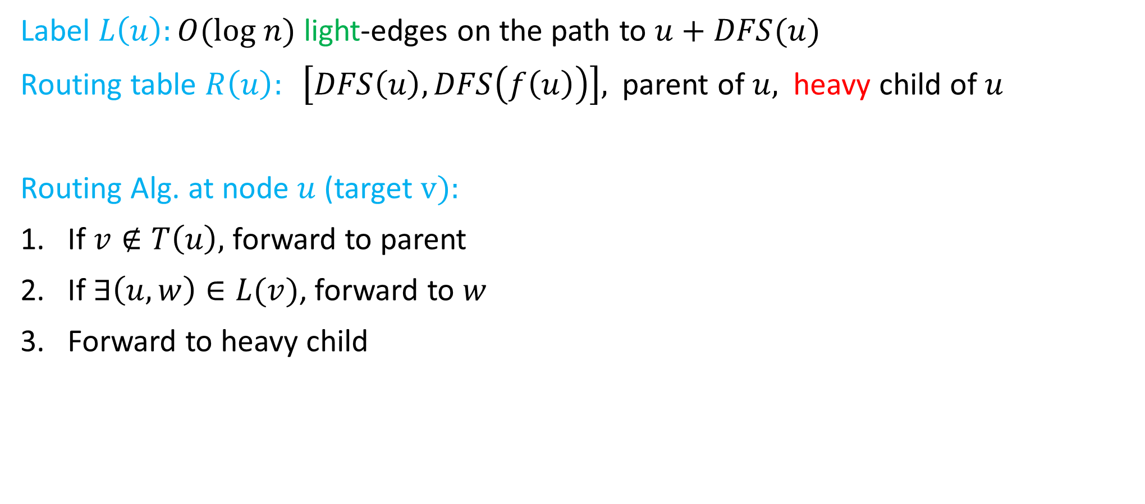
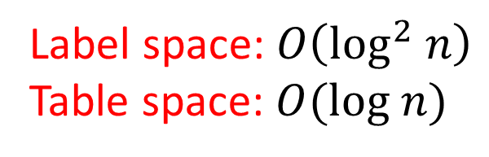

Improved Routing Scheme for Trees
Label $L\left(u\right):O(log n)$ light-edges on the path to $u$ $+ DFS(u)$
Routing table $R\left(u\right): \left[DFS\left(u\right), DFS\left(f\left(u\right)\right)\right],$ parent of $u,$heavy child of $u$
Routing Alg. at node $u$(target $v):$
If $v∉T\left(u\right),$ forward to parent
If $∃\left(u,w\right)∈L(v)$, forward to $w$
Forward to heavy child
$$u$$
$$v$$
Label space: $O\left(\log^{2} n\right)$
Table space: $O(log n)$

Slide 17
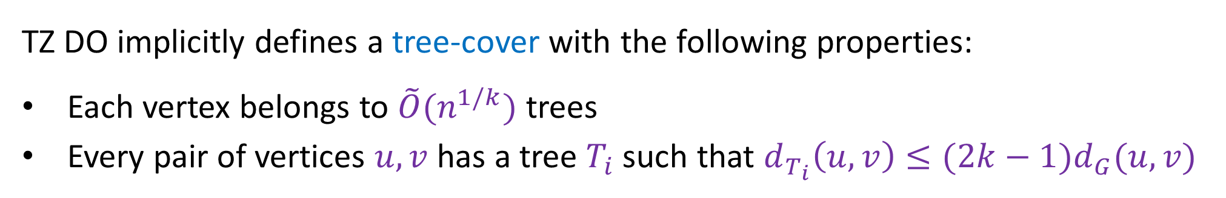

From Trees to General Graphs: Tree Covers
Tree Covers: a family of trees $T=\{ T_{1},…, T_{ℓ}\}$ such that:
For every $u,v$ there is a tree $T_{i}∈T$containing low-stretch path between them.
From routing on general graphs to routing on trees with stretch
TZ DO implicitly defines a tree-cover with the following properties:
Each vertex belongs to $\tilde{O}(n^{1/k})$ trees
Every pair of vertices $u,v$ has a tree $T_{i}$ such that $d_{T_{i}}\left(u,v\right)≤{(2k−1)d}_{G}(u,v)$

Slide 18
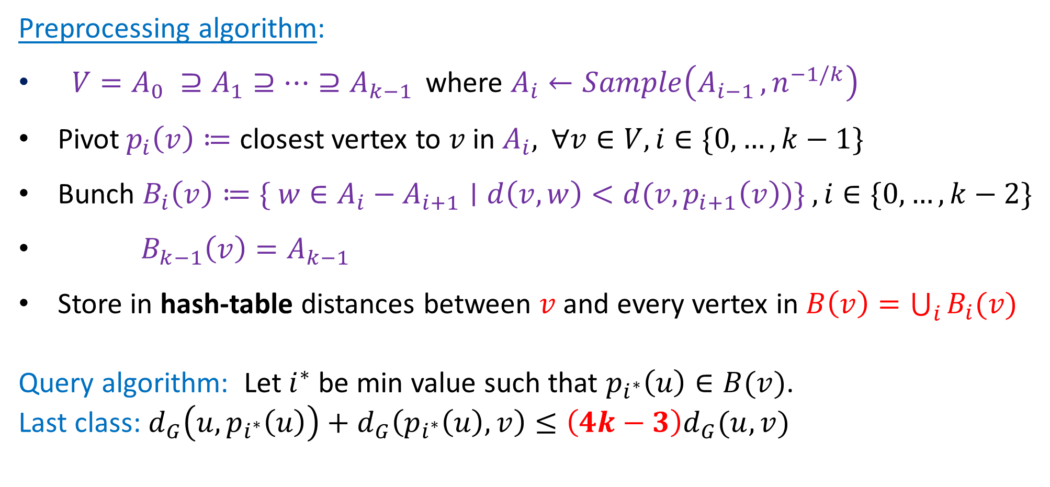
Short Recut of TZ Distance Oracles
Preprocessing algorithm:
$V=A_{0} ⊇A_{1}⊇…⊇A_{k−1 }$where $A_{i}←Sample\left(A_{i−1 },n^{−1/k}\right)$
Pivot$p_{i}\left(v\right)≔$ closest vertex to $v$in $A_{i},$ $∀v∈V, i∈\{0,…,k−1\}$
Bunch $B_{i}\left(v\right)≔\{ w∈A_{i}−A_{i+1}∣d\left(v,w\right)<d(v,p_{i+1}\left(v\right))\} , i∈\{0,…,k−2\}$
$B_{k−1}\left(v\right)=A_{k−1}$
Store in hash-table distances between $v$and every vertex in $B\left(v\right)=\bigcup_{i}{B_{i}(v)}$
Query algorithm: Let $i^{∗}$be min value such that $p_{i^{∗}}\left(u\right)∈B(v)$.
Last class: $d_{G}\left(u,p_{i^{∗}}\left(u\right)\right)+d_{G}\left(p_{i^{∗}}\left(u\right),v\right)≤\left(4k−3\right)d_{G}(u,v)$

Slide 19
Bunches
A₀=
A₁=
A₂=
p₂(v)
v
p₁(v)
$$B_{i}\left(v\right)≔\{ w∈A_{i}−A_{i+1}∣d\left(v,w\right)<{d(v,p}_{i+1}\left(v\right))\}$$
*Slide taken from
Uri Zwick presentation

Slide 20
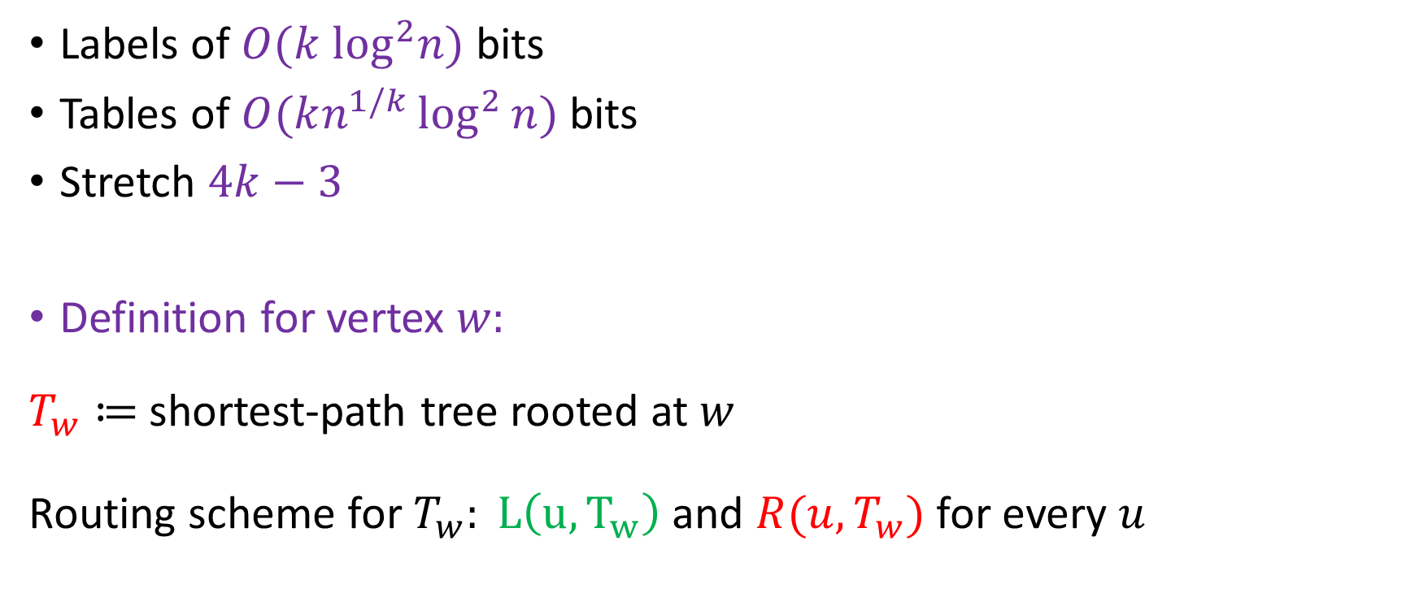
Approximate Routing Schemes for General Graphs
Labels of $O(k \log^{2}n)$ bits
Tables of $O(kn^{1/k}\log^{2}{n)}$bits
Stretch $4k−3$
Definition for vertex $w:$
$T_{w}≔$shortest-path tree rooted at $w$
Routing scheme for $T_{w}: L\left(u, T_{w}\right)$ and $R(u,T_{w})$ for every $u$

Slide 21

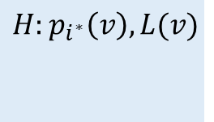
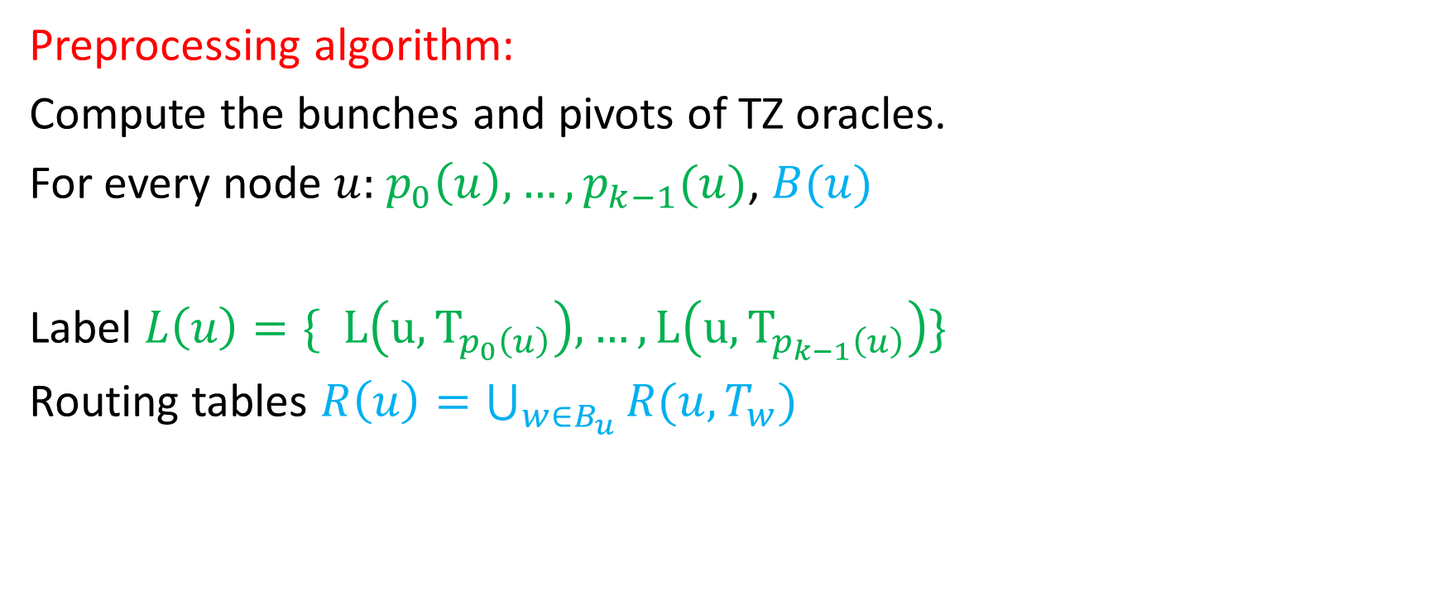

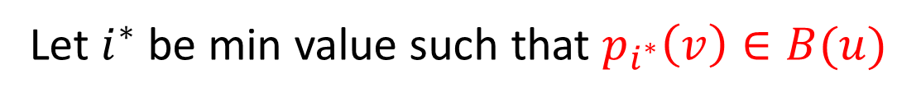

Approximate Routing Schemes for General Graphs
Preprocessing algorithm:
Compute the bunches and pivots of TZ oracles.
For every node $u:$ $p_{0}\left(u\right), …, p_{k−1}(u)$, $B(u)$
Label $L\left(u\right)=\{ L\left(u, T_{p_{0}\left(u\right)}\right), …,L\left(u, T_{p_{k−1}\left(u\right)}\right)\}$
Routing tables $R\left(u\right)=\bigcup_{w∈B_{u}}{R(u,T_{w})}$
$$p_{i^{∗}}(v)$$
$$H:p_{i^{∗}}\left(v\right), L(v)$$
$$v$$
Let $i^{∗}$be min value such that $p_{i^{∗}}\left(v\right)∈B(u)$
$$u$$

Slide 22
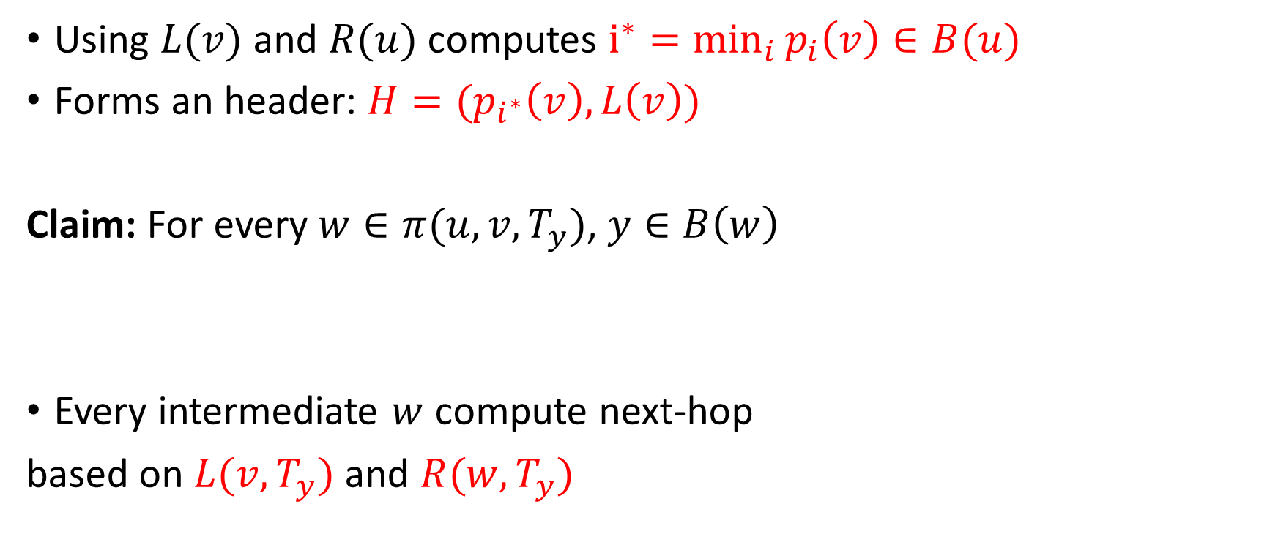






$u$wants to send a message to $v$
Using $L(v)$ and $R(u)$ computes $\underset{i}{i^{∗}=min}{p_{i}\left(v\right)∈B(u)}$
Forms an header: $H=(p_{i^{∗}}\left(v\right), L\left(v\right))$
Claim: For every $w∈π(u,v, T_{y})$, $y∈B\left(w\right)$
Every intermediate $w$ compute next-hop
based on $L(v, T_{y})$ and $R(w,T_{y})$
$${y=p}_{i^{∗}}(v)$$
$$w$$
$$H:p_{i^{∗}}\left(v\right), L(v)$$
$$v$$
$$u$$

Slide 23
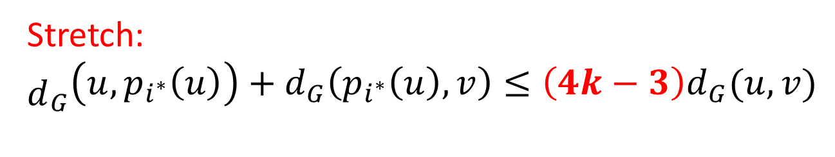
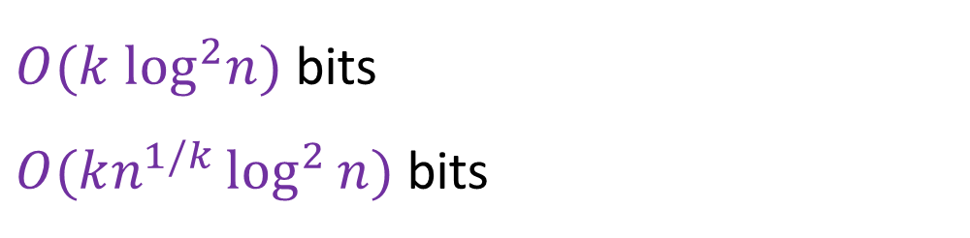





Approximate Routing Schemes for General Graphs
$O(k \log^{2}n)$ bits
$O(kn^{1/k}\log^{2}{n)}$bits
Label $L\left(u\right)=\{ L\left(u, T_{p_{0}\left(u\right)}\right), …,L\left(u, T_{p_{k−1}\left(u\right)}\right)\}$
Routing $R\left(u\right)=\bigcup_{w∈B_{u}}{R(u,T_{w})}$
Stretch:
${\begin{aligned} \\ d\end{aligned}}_{G}\left(u,p_{i^{∗}}\left(u\right)\right)+d_{G}\left(p_{i^{∗}}\left(u\right),v\right)≤\left(4k−3\right)d_{G}(u,v)$
$$p_{i^{∗}}(v)$$
$$w$$
$$v$$
$$u$$

Slide 24
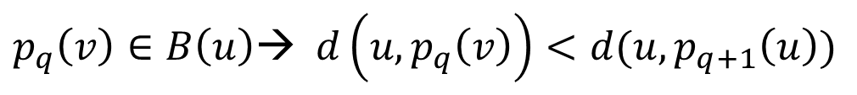

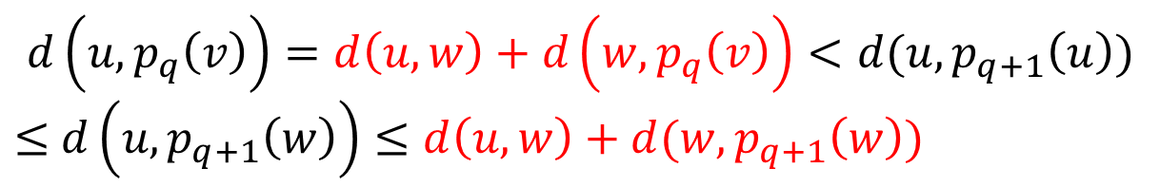


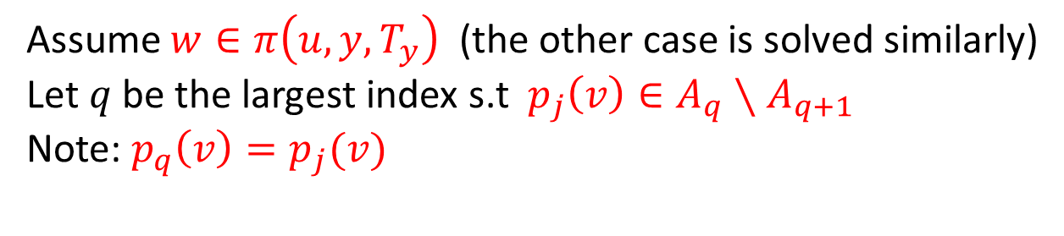
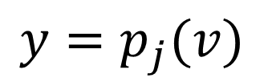

Lemma: If $p_{j}\left(v\right)∈B(u)$ then $p_{j}\left(v\right)∈B\left(w\right)$for every $w∈π(u,v, T_{y})$
Assume $w∈π\left(u,y, T_{y}\right)$ (the other case is solved similarly)
Let $q$be the largest index s.t ${ p}_{j}\left(v\right)∈A_{q}∖A_{q+1}$
Note: $p_{q}\left(v\right)=p_{j}(v)$
$${y=p}_{j}(v)$$
$$w$$
$p_{q}\left(v\right)∈B\left(u\right)$→ $d\left(u,p_{q}\left(v\right)\right)<d(u, p_{q+1}\left(u\right))$
$$d\left(u,p_{q}\left(v\right)\right)=d\left(u,w\right)+d\left(w,p_{q}\left(v\right)\right)<d(u, p_{q+1}\left(u\right))$$
$≤$ $d\left(u, p_{q+1}\left(w\right)\right)≤d\left(u,w\right)+d(w,p_{q+1}\left(w\right))$
$$v$$
$$u$$
$$p_{q}\left(v\right)∈B(w)$$

