Slide 1
Succinct Graph Structures and Their Applications
Spring 2022
Class 8: Gomory-Hu Trees

Slide 2

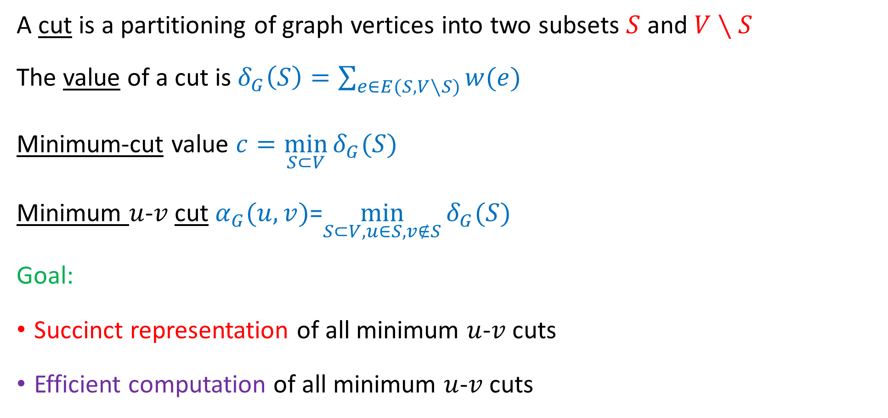

Min-Cut Representation
A cut is a partitioning of graph vertices into two subsets $S$ and $V∖S$
The value of a cut is $δ_{G}\left(S\right)=\sum_{e∈E(S,V∖S)}{w(e)}$
Minimum-cut value $c=\min_{S⊂V}{δ_{G}(S)}$
Minimum $u$-$v$cut $α_{G}(u,v)$=$\min_{S⊂V, u∈S, v∉S}{δ_{G}(S)}$
Goal:
Succinct representation of all minimum $u$-$v$cuts
Efficient computation of all minimum $u$-$v$cuts
$$S$$
$$V\backslash S$$

Slide 3

Flow Tree
Given is a graph $G=(V,E, c)$.
A flow tree is a weighted tree $T=(V,E^{′},w)$ such that for every $u,v∈V:$
$α_{G}\left(u,v\right)=\min_{}{\{w(e)}∣e∈π_{T}(u,v)\}$

Slide 4




Cut Tree
Given is a graph $G=(V,E, c)$.
A cut tree is a unweighted tree $T=(V,E^{′})$ such that for every $\left(u,v\right)∈T:$
$T∖\left\{\left(u,v\right)\right\}$ defines a $u$-$v$ cut in $G$: $V\left(T_{v}\right)$ and $V∖V(T_{v})$
$$u$$
$$v$$
$$T_{v}$$

Slide 5
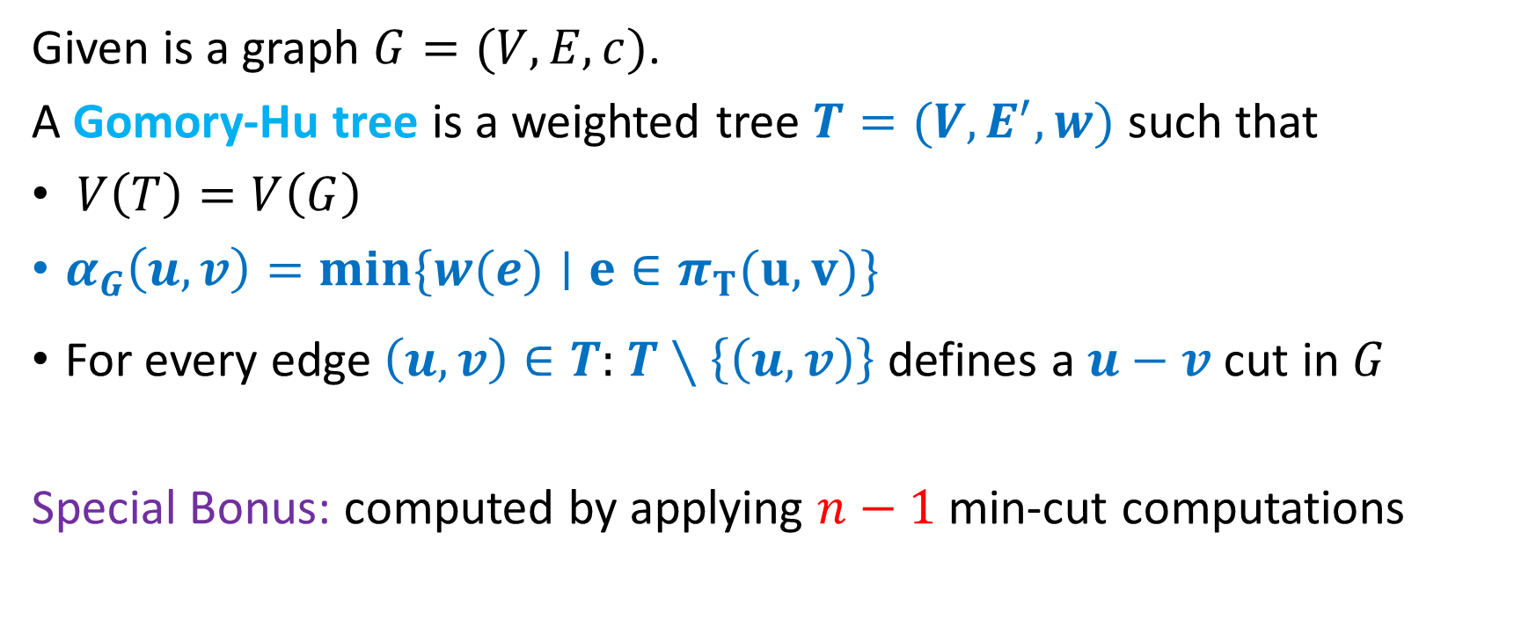
Gomory-Hu Tree
Given is a graph $G=(V,E, c)$.
A Gomory-Hu tree is a weighted tree $T=(V,E^{′},w)$ such that
$V\left(T\right)=V\left(G\right)$
$α_{G}\left(u,v\right)=\min_{}{\{w(e)}∣e∈π_{T}(u,v)\}$
For every edge $\left(u,v\right)∈T:$ $T∖\left\{\left(u,v\right)\right\}$ defines a $u−v$ cut in $G$
Special Bonus: computed by applying $n−1$ min-cut computations

Slide 6





















Gomory-Hu Example:
$$u$$
$$u$$
$$1$$
$$1$$
$$2$$
$$3$$
$$1$$
$$x$$
$$v$$
$$y$$
$$5$$
$$4$$
$$x$$
$$v$$
$$y$$
$$1$$
$$4$$
$$1$$
$$w$$
$$6$$
$$w$$

Slide 7
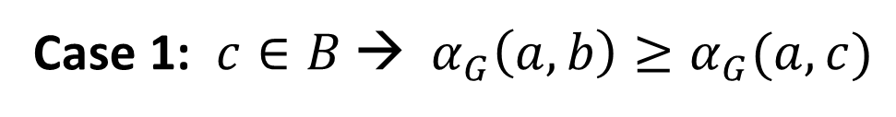






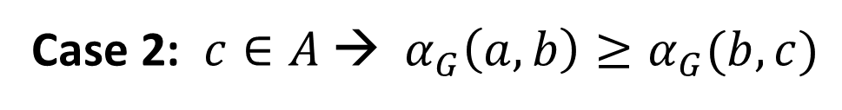
Min-Cut Follows the Triangle Inequality
Lemma 1: $α_{G}\left(a,b\right)≥min\left\{α_{G}\left(a,c\right), α_{G}(c,b) \right\}$ for every $a,b,c$
$$A$$
$$a$$
Case 1: $c∈B$→ $α_{G}\left(a,b\right)≥α_{G}(a,c)$
Case 2: $c∈A$→ $α_{G}\left(a,b\right)≥α_{G}(b,c)$
$$b$$
$$c$$
$$B=V\backslash A$$

Slide 8


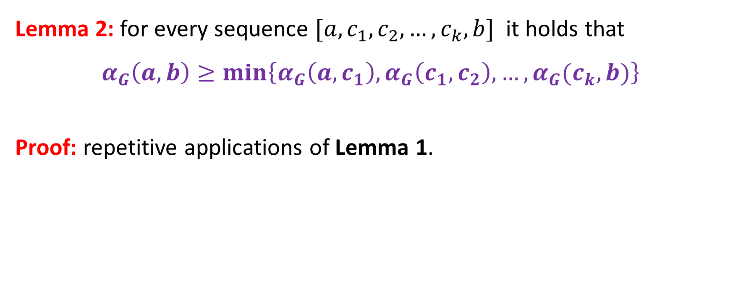



Min-Cut Follows the Triangle Inequality
Lemma 2: for every sequence $[a, c_{1}, c_{2},…,c_{k}, b]$ it holds that
$$α_{G}\left(a,b\right)≥\min\left\{α_{G}\left(a,c_{1}\right), α_{G}\left(c_{1},c_{2}\right),…, α_{G}(c_{k},b)\right\}$$
Proof: repetitive applications of Lemma 1.
$$A$$
$$a$$
$$b$$
$$c$$
$$B=V\backslash A$$

Slide 9
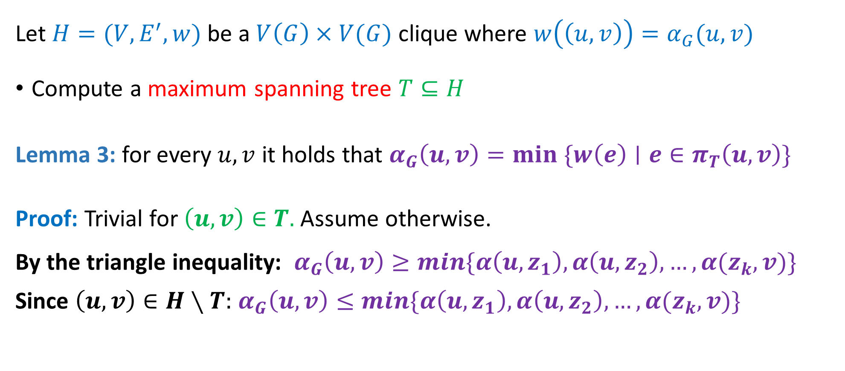

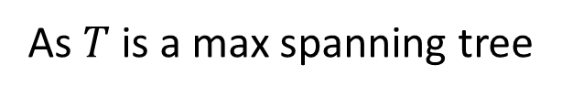
Flow Tree with $O(n^{2})$ Min-Cut Computations
Let $H=(V,E^{′},w)$ be a $V\left(G\right)×V(G)$ clique where $w\left(\left(u,v\right)\right)=α_{G}(u,v)$
Compute a maximum spanning tree $T⊆H$
Lemma 3: for every $u,v$ it holds that $α_{G}\left(u,v\right)=\underset{}{min \{w\left(e\right)∣e∈π_{T}\left(u,v\right)\}}$
Proof: Trivial for $\left(u,v\right)∈T.$ Assume otherwise.
By the triangle inequality: $α_{G}\left(u,v\right)≥min\{α\left(u,z_{1}\right), α\left(u,z_{2}\right),…,α(z_{k},v)\}$
Since $\left(u,v\right)∈H∖T:$ $α_{G}\left(u,v\right)≤min\{α\left(u,z_{1}\right), α\left(u,z_{2}\right),…,α(z_{k},v)\}$
As $T$ is a max spanning tree

Slide 10
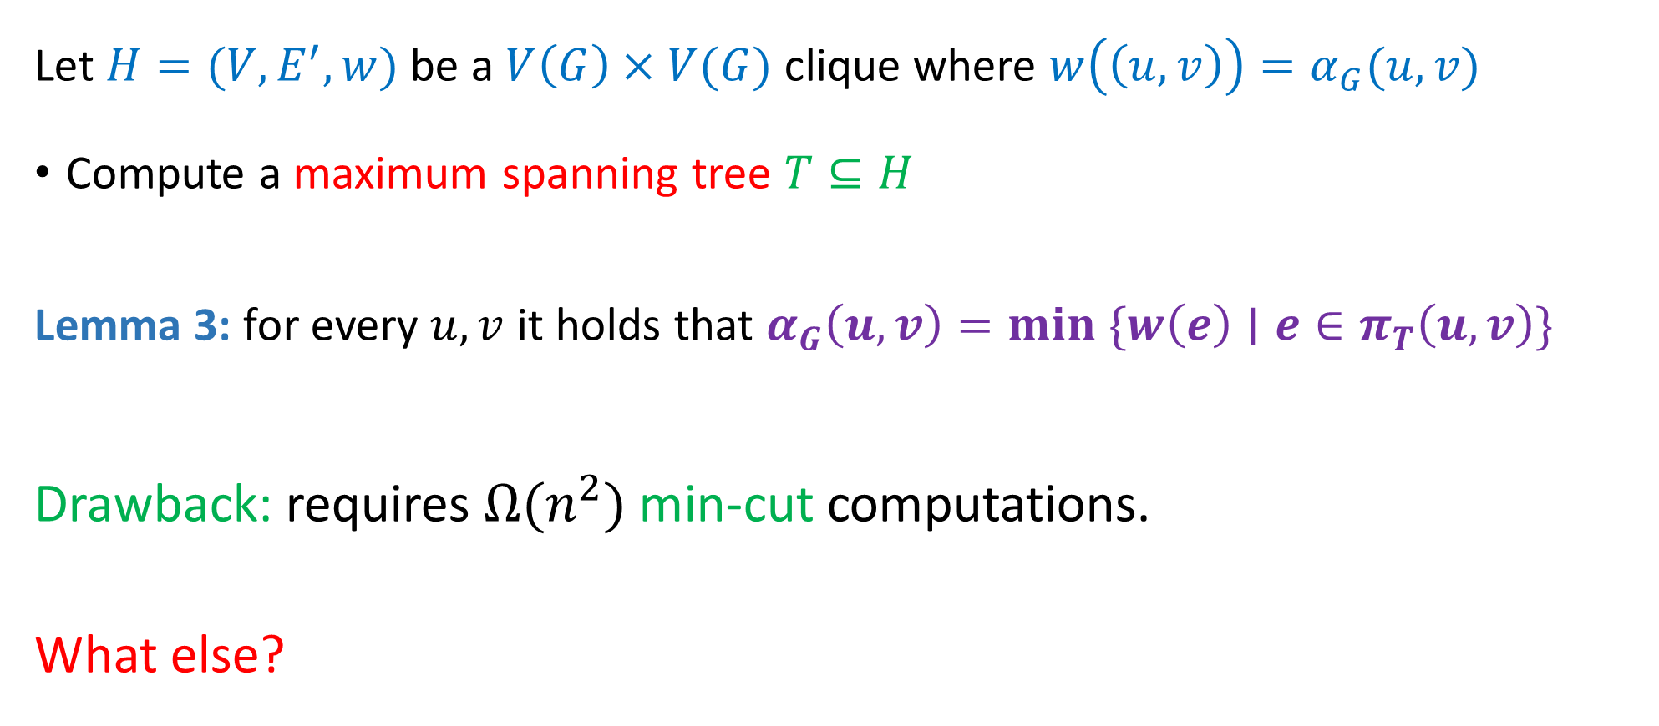

Tree with $O(n^{2})$ Min-Cut Computations
Let $H=(V,E^{′},w)$ be a $V\left(G\right)×V(G)$ clique where $w\left(\left(u,v\right)\right)=α_{G}(u,v)$
Compute a maximum spanning tree $T⊆H$
Lemma 3: for every $u,v$ it holds that $α_{G}\left(u,v\right)=\underset{}{min \{w\left(e\right)∣e∈π_{T}\left(u,v\right)\}}$
Drawback: requires $Ω(n^{2})$ min-cut computations.
What else?

Slide 11


















$$G$$
Flow-Tree
$$1$$
$$2$$
$$1$$
$$2$$
$$3$$
$$1$$
$$3$$
$$1$$
$$1$$
$$3$$
$$1$$
$$4$$
$$4$$
$$1$$
$$5$$
$$5$$
$$6$$
Note: is not a cut-tree

Slide 12
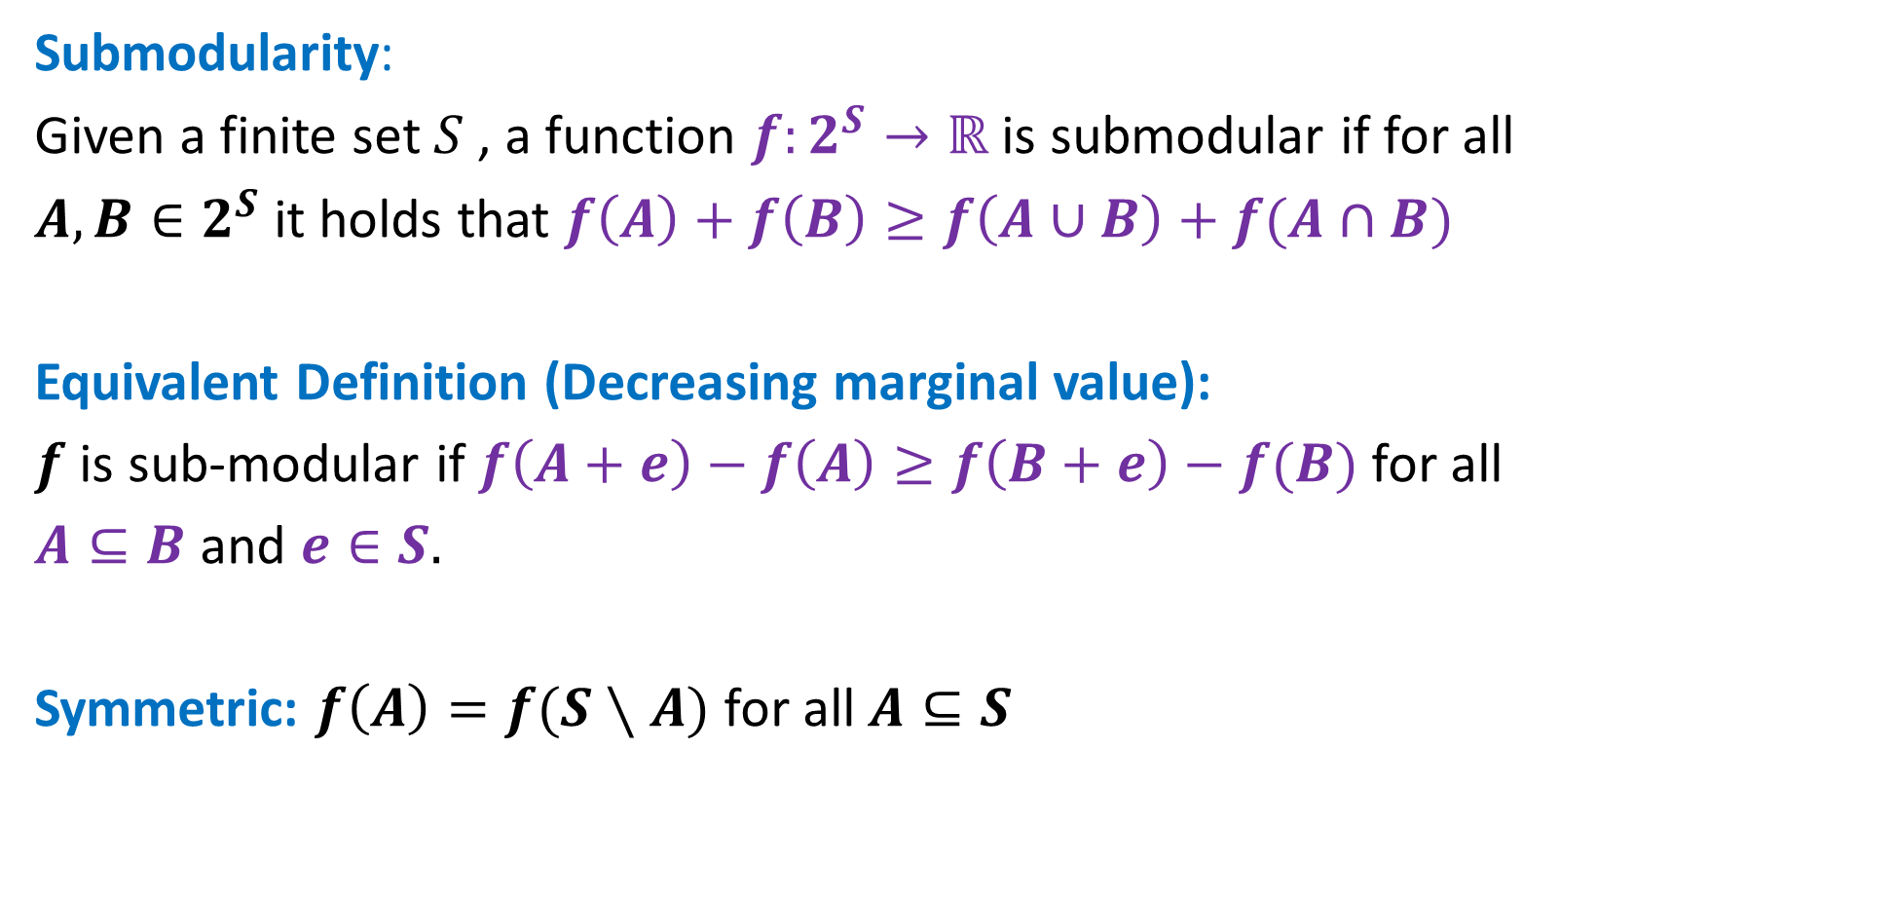
Nice Properties of Cuts
Submodularity:
Given a finite set $S$ , a function $f:2^{S}→ℝ$ is submodular if for all
$A,B∈2^{S}$ it holds that $f\left(A\right)+f\left(B\right)≥f\left(A∪B\right)+f(A∩B)$
Equivalent Definition (Decreasing marginal value):
$f$ is sub-modular if $f\left(A+e\right)−f\left(A\right)≥f\left(B+e\right)−f(B)$ for all
$A⊆B$ and $e∈S.$
Symmetric: $f\left(A\right)=f(S∖A)$ for all $A⊆S$

Slide 13




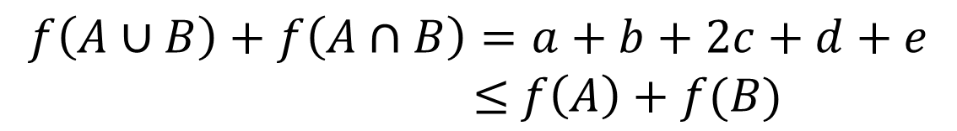









Nice Properties of Cuts
$$A$$
In our case graph $G(V,E)$ and $f:2^{V}→ℝ$ where $f\left(A\right)=δ(A)$
$$V∖A$$
Lemma: The cut function is submodular
Diagram with all classes of edges (except fully inside $A,B, V∖(A∪B))$
$$a$$
$$b$$
$$f\left(A\right)+f\left(B\right)=a+b+2c+d+e+2f$$
$$c$$
$$f\left(A∪B\right)=a+b+c$$
$$A$$
$$e$$
$$B$$
$$d$$
$$f\left(A∩B\right)=c+d+e$$
$$f\left(A∪B\right)+f\left(A∩B\right)=a+b+2c+d+e$$
$≤$ $f\left(A\right)+f(B)$
$$f$$

Slide 14

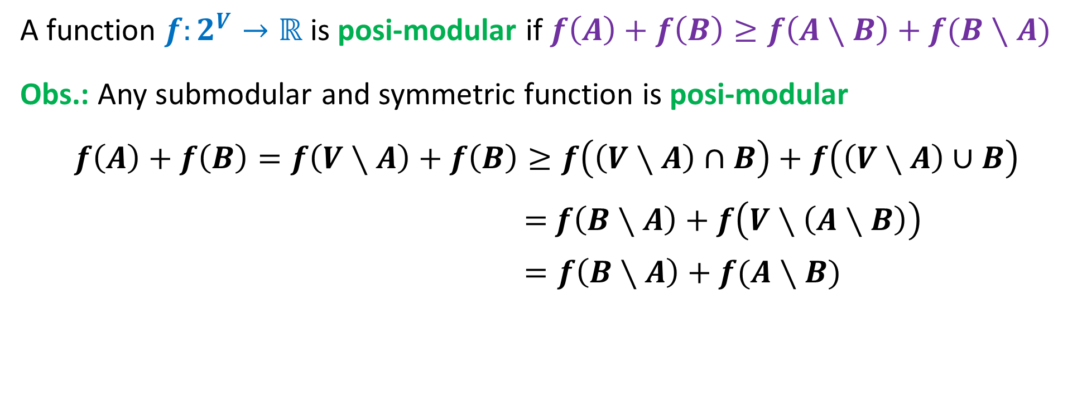
Nice Properties of Cuts
A function $f:2^{V}→ℝ$ is posi-modular if $f\left(A\right)+f\left(B\right)≥f\left(A∖B\right)+f(B∖A)$
Obs.: Any submodular and symmetric function is posi-modular
$$f\left(A\right)+f\left(B\right)=f\left(V∖A\right)+f\left(B\right)≥f\left(\left(V∖A\right)∩B\right)+f\left(\left(V∖A\right)∪B\right)$$
$=$ $f\left(B∖A\right)+f\left(V∖\left(A∖B\right)\right)$
$=f\left(B∖A\right)+f(A∖B)$
The cut function $f\left(A\right)=δ(A)$ is posi-modular

Slide 15










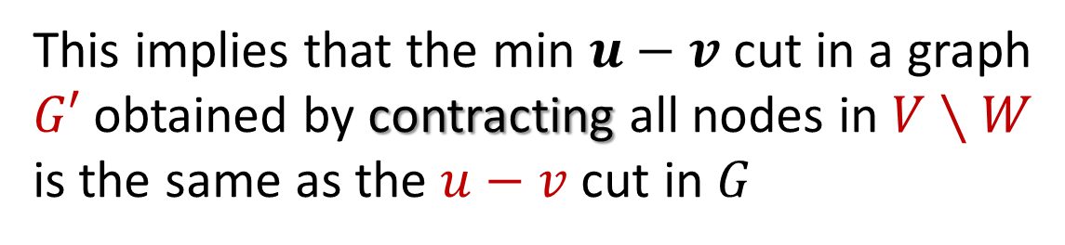



The Key Lemma: Non-Crossed Cuts
Key Lemma: Let $δ(W)$ be an $s,t$ minimum-cut in a graph $G.$
For every $u,v∈W$ there is a min $u,v$ cut $δ(X)$ in $G$where $X⊆W.$
This implies that the min $u−v$ cut in a graph
$G′$ obtained by contracting all nodes in $V∖W$
is the same as the $u−v$ cut in $G$
$$V∖W$$
$$t$$
$$v$$
$$u$$
$$s$$
$$t$$
$$X$$
$$u$$
$$X$$
$$v$$
$$W$$
$$W$$

Slide 16






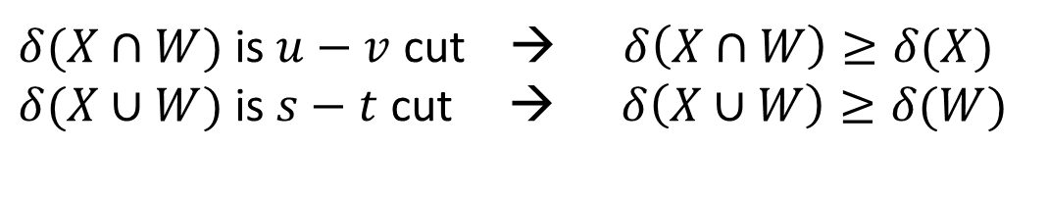

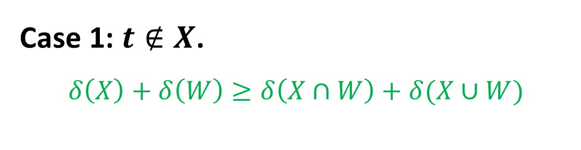


Key Lemma: Let $δ(W)$ be an $s,t$ minimum-cut in a graph $G.$
For every $u,v∈W$ there is a min $u,v$ cut $δ(X)$ in $G$where $X⊆W.$
Let $δ(X)$ be any $u,v$ min cut that crosses $W.$W.l.o.g. assume that $s∈W,s∈X$ and $u∈X$
Case 1: $t∉X$.
$$δ\left(X\right)+δ\left(W\right)≥δ\left(X∩W\right)+δ(X∪W)$$
$$X$$
$$t$$
submodularity
$δ(X∩W)$ is $u−v$ cut → $δ\left(X∩W\right)≥δ(X)$
$δ(X∪W)$ is $s−t$ cut → $δ\left(X∪W\right)≥δ(W)$
$$u$$
$$δ\left(X\right)+δ\left(W\right)≤δ\left(X∩W\right)+δ(X∪W)$$
$$s$$
$$W$$
$$v$$
$$δ\left(X\right)=δ\left(X∩W\right)$$

Slide 17

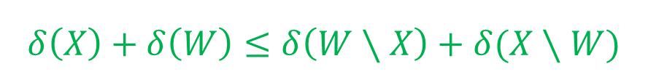
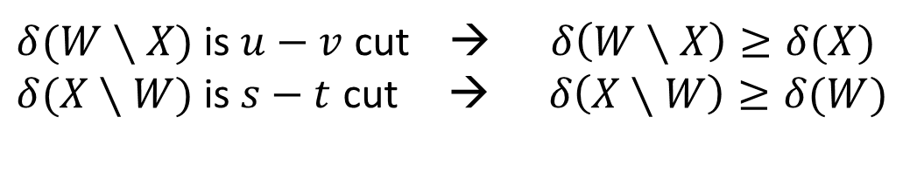
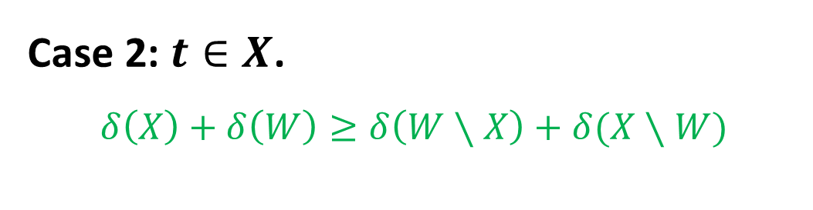

Key Lemma: Let $δ(W)$ be an $s,t$ minimum-cut in a graph $G.$
For every $u,v∈W$ there is a min $u,v$ cut $δ(X)$ in $G$where $X⊆W.$
Let $δ(X)$ be any $u,v$ min cut that crosses $W.$W.l.o.g. assume that $s∈W,s∈X$ and $u∈X$
Case 2: $t∈X$.
$$δ\left(X\right)+δ\left(W\right)≥δ\left(W∖X\right)+δ(X∖W)$$
$$X$$
Posi-modularity
$$t$$
$δ(W∖X)$ is $u−v$ cut → $δ\left(W∖X\right)≥δ(X)$
$δ(X∖W)$ is $s−t$ cut → $δ\left(X∖W\right)≥δ(W)$
$$u$$
$$δ\left(X\right)+δ\left(W\right)≤δ\left(W∖X\right)+δ(X∖W)$$
$$s$$
$$W$$
$$v$$
$$δ\left(X\right)=δ\left(W∖X\right)$$

Slide 18

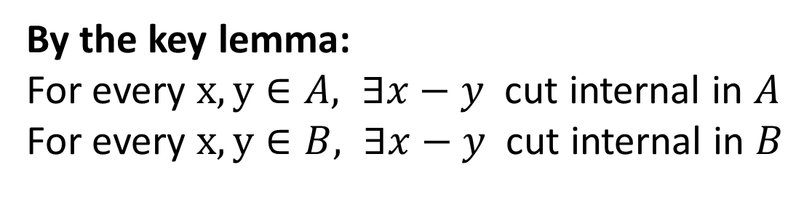




High-Level Intuition
Compute an $a−b$ minimum cut for an arbitrary pair $a,b$
$$A$$
$$B$$
$$a$$
$$b$$
By the key lemma:
For every $x,y∈A, ∃x−y$ cut internal in $A$
For every $x,y∈B, ∃x−y$ cut internal in $B$

Slide 19














High-Level Intuition
Compute a $s−t$ minimum cut for arbitrary pair $a,b$
$$A$$
$$α_{G}(a,b)$$
Break the task into
two independent
computations!
$$B$$
$$a$$
$$b$$
Compute tree $T_{B}$
for $G_{B}$
$$A$$
$$v_{B}$$
$$v_{A}$$
Compute tree $T_{A}$
for $G_{A}$
$$B$$
$$G_{A}$$
$$G_{B}$$

Slide 20




High-Level Intuition
Collapsing a set $B$ into a vertex $v_{B}$:
For each $v∈A$ add edge $(v,v_{B})$ of weight
$w\left(v,v_{B}\right)=\sum_{\left(v,u\right)∈G∣u∈B}{w(v,u)}$
$$A$$
$$v_{B}$$
$$G_{A}$$

Slide 21








High-Level Intuition
Compute a $a−b$ minimum cut for an arbitrary pair $a,b$
$$A$$
$$α_{G}(a,b)$$
Break the task into
two independent
computations!
$$B$$
$$a$$
$$b$$
$$A$$
$$T_{A}$$
$$α_{G}(a,b)$$
$$T_{B}$$
Compute tree $T_{B}$
for $G_{B}$
Compute tree $T_{A}$
for $G_{A}$
$$B$$

Slide 22





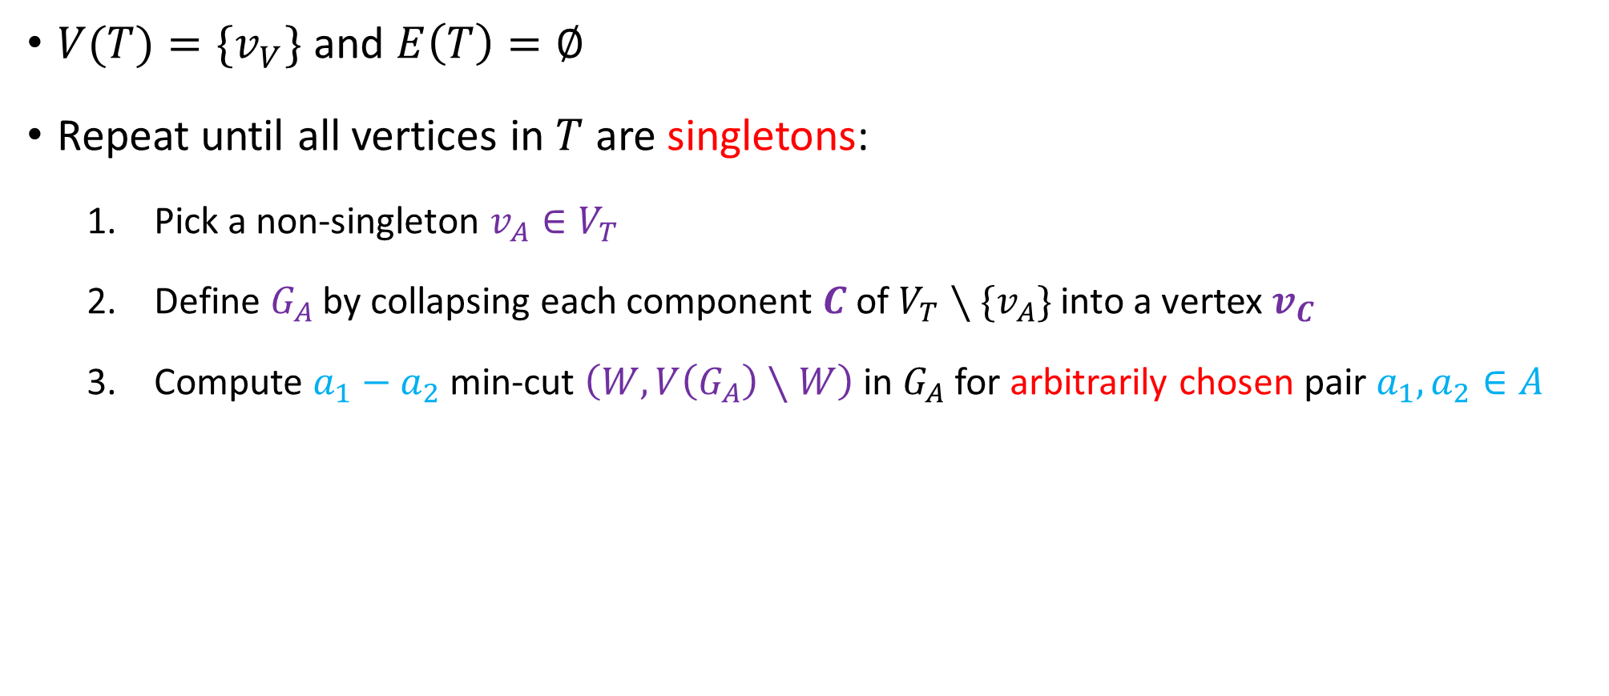







Gomory-Hu Algorithm
$V(T)=\{v_{V}\}$ and $E\left(T\right)=∅$
Repeat until all vertices in $T$ are singletons:
  Pick a non-singleton $v_{A}∈V_{T}$
  Define $G_{A}$ by collapsing each component $C$ of $V_{T}∖{\{v}_{A}\}$ into a vertex $v_{C}$
  Compute $a_{1}−a_{2}$ min-cut $\left(W,V\left(G_{A}\right)∖W\right)$in $G_{A}$ for arbitrarily chosen pair $a_{1},a_{2}∈A$
$$A$$
$$α_{G}(a_{1},a_{2})$$
$$a_{1}$$
$$A_{1}$$
$$A_{2}$$
$$W$$
$$a_{2}$$
$$a_{1}$$
$$a_{2}$$
$$Y$$
$$Y′$$
$$V\left(G_{A}\right)∖W$$

Slide 23
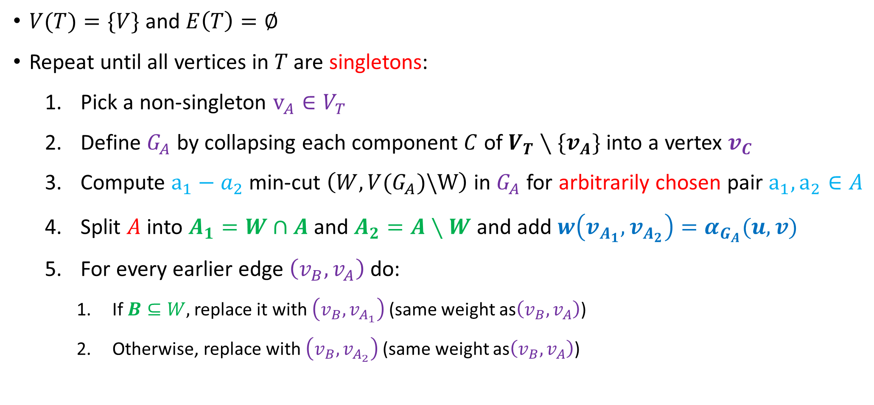
Gomory-Hu Algorithm
$V(T)=\{V\}$ and $E\left(T\right)=∅$
Repeat until all vertices in $T$ are singletons:
  Pick a non-singleton $v_{A}∈V_{T}$
  Define $G_{A}$ by collapsing each component $C$ of $V_{T}∖{\{v}_{A}\}$ into a vertex $v_{C}$
  Compute $a_{1}−a_{2}$ min-cut $\left(W,V(G_{A})\backslash W\right)$in $G_{A}$ for arbitrarily chosen pair $a_{1},a_{2}∈A$
  Split $A$ into $A_{1}=W∩A$ and $A_{2}=A∖W$ and add $w\left(v_{A_{1}},v_{A_{2}}\right)=α_{G_{A}}(u,v)$
  For every earlier edge $\left(v_{B},v_{A}\right)$ do:
    If $B⊆W,$ replace it with $\left(v_{B},v_{A_{1}}\right)$(same weight as$\left(v_{B},v_{A}\right)$)
    Otherwise, replace with $\left(v_{B},v_{A_{2}}\right)$(same weight as$\left(v_{B},v_{A}\right)$)

Slide 24


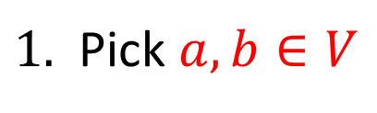

















Illustration
$$3$$
$$a$$
$$f$$
$$1$$
$$6$$
$$a,b,c,$$
$$d,e,f$$
$$2$$
$$c$$
$$1$$
$$1$$
$$b$$
$$2$$
$$7$$
$$d$$
$$e$$
$$4$$
$1.$ Pick $a,b∈V$
$$6$$
$$a,c,e,d$$
$$b,f$$

Slide 25







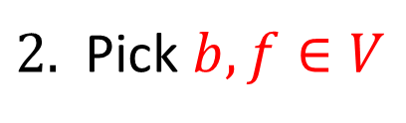


















$2.$ Pick $b,f∈V$
$$3$$
$$a$$
$$f$$
$$f$$
$$1$$
$$6$$
$$4$$
$$6$$
$$2$$
$$c$$
$$1$$
$$1$$
$$b$$
$$v_{A}$$
$$b$$
$$2$$
$$2$$
$$7$$
$$d$$
$$e$$
$$4$$
$$6$$
$$8$$
$$a,c,e,d$$
$$f$$
$$b$$

Slide 26







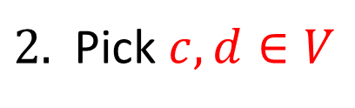























$2.$ Pick $c,d∈V$
$$3$$
$$3$$
$$a$$
$$f$$
$$a$$
$$f$$
$$1$$
$$1$$
$$6$$
$$6$$
$$2$$
$$2$$
$$c$$
$$1$$
$$1$$
$$c$$
$$1$$
$$1$$
$$b$$
$$2$$
$$2$$
$$7$$
$$7$$
$$d$$
$$e$$
$$d$$
$$e$$
$$4$$
$$4$$
$$8$$
$$6$$
$$8$$
$$c$$
$$a,d,e$$
$$f$$
$$b$$

Slide 27



































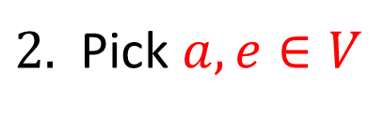


$2.$ Pick $a,e∈V$
$$3$$
$$3$$
$$f$$
$$a$$
$$f$$
$$a$$
$$1$$
$$6$$
$$6$$
$$1$$
$$2$$
$$2$$
$$c$$
$$1$$
$$1$$
$$b$$
$$c$$
$$1$$
$$1$$
$$b$$
$$2$$
$$2$$
$$7$$
$$d$$
$$e$$
$$7$$
$$d$$
$$e$$
$$4$$
$$4$$
$$8$$
$$6$$
$$8$$
$$c$$
$$d,e$$
$$f$$
$$b$$
$$7$$
$$a$$

Slide 28














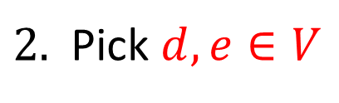


$2.$ Pick $d,e∈V$
$$3$$
$$3$$
$$a$$
$$f$$
$$a$$
$$f$$
$$1$$
$$1$$
$$6$$
$$6$$
$$2$$
$$2$$
$$1$$
$$1$$
$$c$$
$$1$$
$$1$$
$$b$$
$$c$$
$$2$$
$$2$$
$$7$$
$$d$$
$$e$$
$$7$$
$$d$$
$$e$$
$$4$$
$$4$$
$$8$$
$$6$$
$$6$$
$$8$$
$$c$$
$$d$$
$$e$$
$$f$$
$$b$$
$$7$$
$$a$$

Slide 29






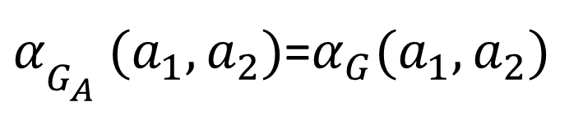


Correctness Analysis
Claim 1:
$α_{G_{A}^{}}(a_{1},a_{2})$=$α_{G}(a_{1},a_{2})$
$$α_{G^{′}}(u,v)$$
$$A$$
$$a_{1}$$
$$A_{1}$$
$$A_{2}$$
$$a_{1}$$
$$a_{2}$$
$$a_{2}$$
Claim 2: For every edge $\left(u,v\right)∈T, δ\left(V(T_{v})\right)=α_{G}(u,v)$

Slide 30
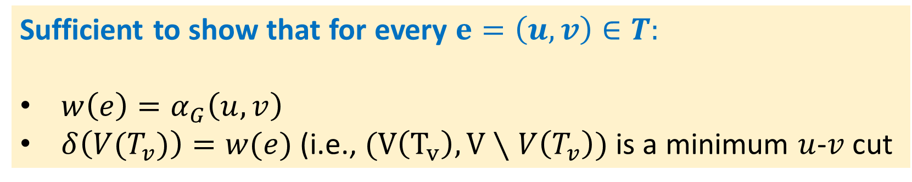
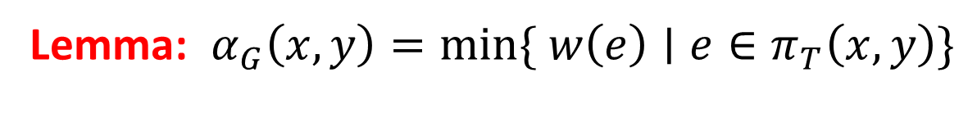
Correctness Analysis
Lemma: $α_{G}\left(x,y\right)=min\{ w\left(e\right)∣e∈π_{T}\left(x,y\right)\}$
Sufficient to show that for every $e=\left(u,v\right)∈T:$
$w\left(e\right)=α_{G}\left(u,v\right)$
$δ\left({V(T}_{v})\right)=w(e)$ (i.e., $(V\left(T_{v}\right), V∖V\left(T_{v}\right))$ is a minimum $u$-$v$cut
Why?

Slide 31

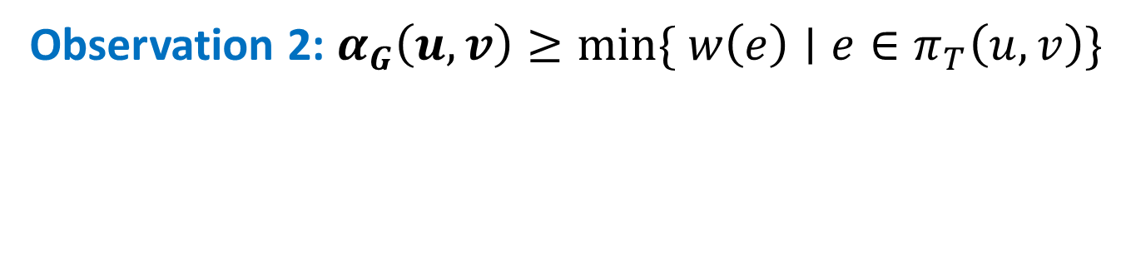

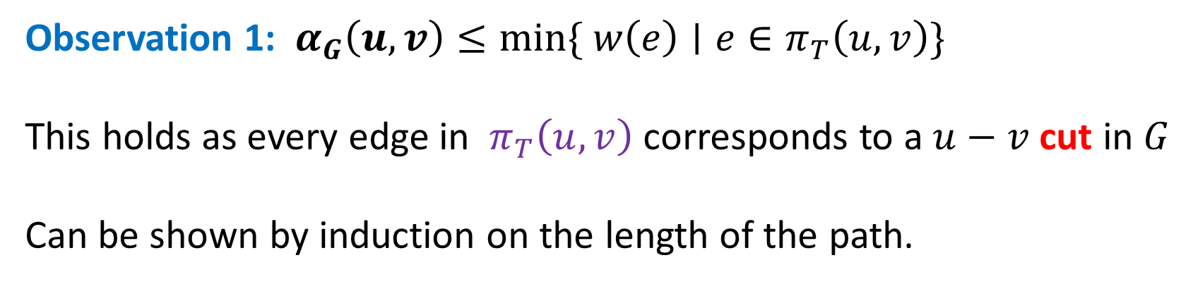




Correctness Analysis
Observation 1: $α_{G}\left(u,v\right)≤min\{ w\left(e\right)∣e∈π_{T}\left(u,v\right)\}$
This holds as every edge in $π_{T}\left(u,v\right)$ corresponds to a $u−v$ cut in $G$
Can be shown by induction on the length of the path.
$$T$$
$$q_{2}$$
Observation 2: $α_{G}\left(u,v\right)≥min\{ w\left(e\right)∣e∈π_{T}\left(u,v\right)\}$
$$q_{1}$$
$$q_{k}$$
$$u$$
$$v$$

Slide 32

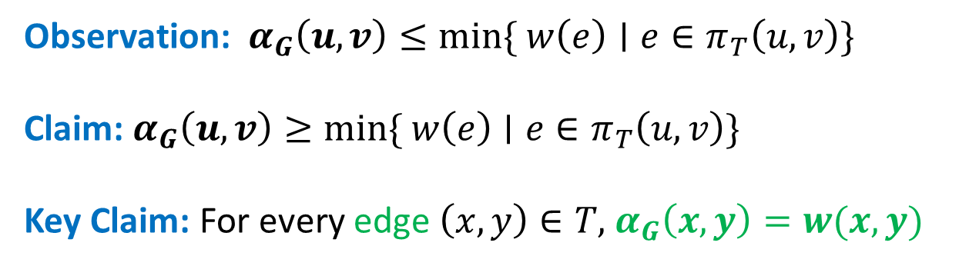




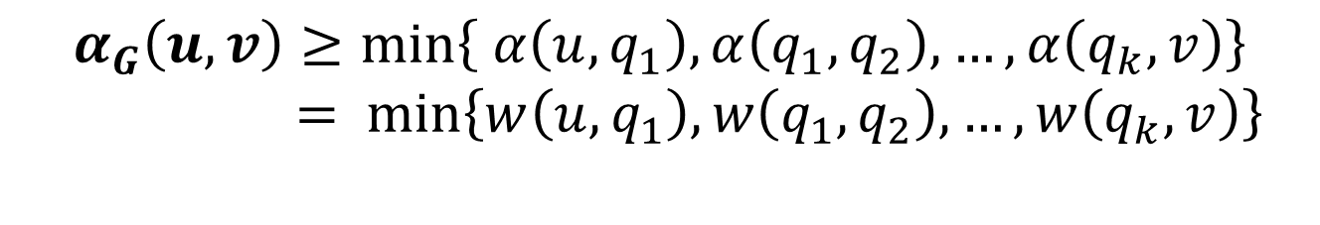


Correctness Analysis
Lemma: $α_{G}\left(u,v\right)=min\{ w\left(e\right)∣e∈π_{T}\left(u,v\right)\}$
$$T$$
Observation: $α_{G}\left(u,v\right)≤min\{ w\left(e\right)∣e∈π_{T}\left(u,v\right)\}$
Claim: $α_{G}\left(u,v\right)≥min\{ w\left(e\right)∣e∈π_{T}\left(u,v\right)\}$
Key Claim: For every edge $\left(x,y\right)∈T,$ $α_{G}\left(x,y\right)=w(x,y)$
$$q_{2}$$
$$q_{1}$$
$$q_{k}$$
$$u$$
$$v$$
Triangle ineq.
$$α_{G}\left(u,v\right)≥min\left\{ α\left(u,q_{1}\right), α\left(q_{1},q_{2}\right), …, α\left(q_{k}, v\right)\right\}$$
$$= \min\left\{w\left(u,q_{1}\right), w\left(q_{1},q_{2}\right), …, w\left(q_{k},v\right)\right\}$$

Slide 33
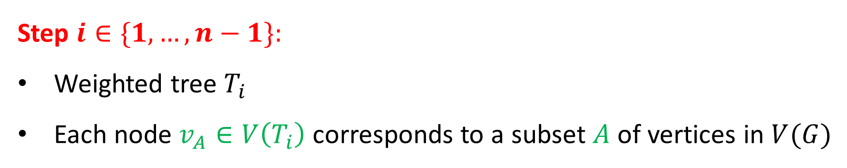
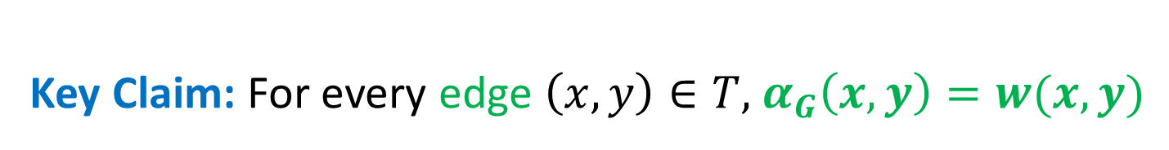
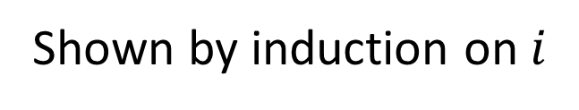

Correctness Analysis
Key Claim: For every edge $\left(x,y\right)∈T,$ $α_{G}\left(x,y\right)=w(x,y)$
Step $i∈\{1,…, n−1\}:$
Weighted tree $T_{i}$
Each node $v_{A}∈V\left(T_{i}\right)$ corresponds to a subset $A$ of vertices in $V(G)$
Claim: For every edge $\left(v_{X},v_{Y}\right)∈T_{i}$ there exists $x∈X, y∈Y$ such that
$$w\left(v_{X},v_{Y}\right)=α_{G}(x,y)$$
Shown by induction on $i$

Slide 34
















Correctness Analysis
Claim: For every edge $\left(v_{X},v_{Y}\right)∈T_{i}$ there exists $x∈X, y∈Y$ such that
$$w\left(v_{X},v_{Y}\right)=α_{G}(x,y)$$
Base of induction: $T_{1}$ has no edges, trivial
Induction step $i:$ Split a super-vertex $v_{A}∈T_{i−1}$ into $A_{1},A_{2}$
$$α_{G′}(a_{1},a_{2})$$
$$a_{1}$$
$$A$$
$$a_{1}$$
$$T_{i−1}$$
$$a_{2}$$
$$A_{1}$$
$$A_{2}$$
$$a_{2}$$
$$T_{i}$$
$$B$$
$$C$$
$$B$$
$$C$$

Slide 35

















Correctness Analysis
Claim: For every edge $\left(X,Y\right)∈T_{i}$ there exists $x∈X, y∈Y$ such that
$$w\left(X,Y\right)=α_{G}(x,y)$$
Base of induction: $T_{1}$ has no edges, trivial
Induction step $i:$ Split a super-vertex $A∈T_{i−1}$ into $A_{1},A_{2}$
$$A$$
$$a_{1}$$
$$α_{G}(a_{1},a_{2})$$
$$T_{i−1}$$
$$a_{1}$$
$$a_{2}$$
$$A_{2}$$
$$A_{1}$$
$$a_{2}$$
$$T_{i}$$
$$B$$
$$C$$
$$B$$
$$C$$
Show that claim is preserved for $\left(A_{1},B\right)!$

Slide 36




















Correctness Analysis
Induction step $i:$ Split a super-vertex $A∈T_{i−1}$ into $A_{1},A_{2}$
$$a_{1}$$
$$α_{G}(a_{1},a_{2})$$
$$A_{2}$$
$$T_{i−1}$$
$$a_{1}$$
$$A$$
$$a_{2}$$
$$A_{1}$$
$$a_{}$$
$$a$$
$$a_{2}$$
$$α(a,b)$$
$$C$$
$$B$$
$$T_{i}$$
$$B$$
$$C$$
$$b$$
$$b$$
By induction assumption for $i−1$: $∃a∈A$ and $b∈B$such that $w\left(v_{A},v_{B}\right)=α(a,b)$
If $a∈A_{1}$ ☺
Otherwise, show $∃a^{′}∈A_{1}$ such that:
${w\left(A,B\right)=α}_{G}\left(a,b\right)=α_{G}\left(a^{′},b\right)=w(A_{1},B)$

Slide 37















By the triangle inequality:
$$a_{1}$$
$$α_{G}(a_{1},a_{2})$$
$$A_{2}$$
$$A_{1}$$
$$a_{}$$
$$α\left(b,a_{1}\right)≥\min{\{α\left(b,a\right), α\left(a,a_{2}\right), α(a_{2},a_{1})\}}$$
$$a_{2}$$
$$T_{i}$$
$$B$$
$$C$$
By the key lemma:
collapsing $A_{2}$ does not change value of $α(b,a_{1})$
$$b$$
$$α\left(b,a_{1}\right)≥\min{\{α\left(b,a\right),α(a_{2},a_{1})\}}$$
The $a_{1}−a_{2}$ min cut also separates $a$ and $b,$thus $α\left(a,b\right)≤α(a_{1},a_{2})$
$$α_{G}\left(b,a_{1}\right)≥α_{G}\left(b,a\right)$$
As there is an $b−a_{1}$ cut of value $α_{G}\left(a,b\right)$
$$α_{G}\left(b,a_{1}\right)=α_{G}\left(b,a\right)$$

Slide 38

Implications
For any undirected graph there is a pair of nodes $s,t$ such that
there is an $s−t$ min cut that consists of a singleton node
(a.k.a pendant pair).
Let G be a graph such that $deg⁡(v) ≥ k$for all $v ∈ V$then there is a pair such that $α_{G}\left(s,t\right)≥k$
Submodularity and symmetry are sufficient conditions for tree representation with $n−1$ computations.

